Slide 2
Connections in Collaborative Collection Development
Ardys Kozbial, Assistant University Librarian for Content Strategies

Slide 3
Heard or read in the past year
Collaborative collection development
What does that mean?
Collectively collecting
Strategic duplication
Collaboratively collecting
We already collaborate
Princeton doesn’t share
Collective collections
We collect for everyone
I know what they collect and they know what I collect

Slide 4
Changes Affecting Collection Development
Borrowing, lending, and access agreements
Budget distribution
Working collaboratively allows us to bring more unique resources to our users

Slide 5
Communication and Formal Agreements
Conversations about collecting areas
Negotiations about minimizing redundancy
Making agreements, writing them down, and making them public
Creating MOUs that are formal agreements

Slide 6
Go to diagram

Slide 7
University Publications Task Force
What is it?
collaboration
Develop a common understanding of what constitutes a University publication, in both analog and digital forms, and determine who is responsible for stewarding these resources
Working on final report
Membership includes archivists and librarians from across Harvard Library
Define University publication
Debate the difference between collecting and retaining
Survey collection development colleagues across Harvard Library

Slide 8
IPLC Web Collecting Program
What is it?
Collaboration
Collaborative collection development effort to build curated, thematic collections of freely available, at-risk web content in order to support research at participating libraries and beyond
Program requires that each collection proposal come from at least 2 selectors at different IPLC institutions
Harvard Library has the highest participation of all IPLC institutions in this program

Slide 9
NEFLLCG
What is it?
collaboration
North East Foreign Law Library Cooperative Group
Started by law school libraries in New York City in 1989
Coordinates acquisition of non-US legal materials
Originally each library took responsibility for collecting basic legal materials for under-collected countries
Informal and formal at the same time
Commitment to acquiring material for a country that matched curriculum and domain expertise
Currently undertaking a refresh of this work

Slide 10
Ongoing Collaborations in Collection Development
Working deliberately
Adding connections
Each part makes up the whole
A conversation with the future

Slide 11
Thank you.

Slide 12
Shared Index Initiatives & Google Scanning
Suzanne Wones, Associate University Librarian for Digital Strategies and Innovations

Slide 13
Operational Statistics & Mindful Self-Compassion
Rachel Lewellen, Head of Assessment and Program Management

Slide 14
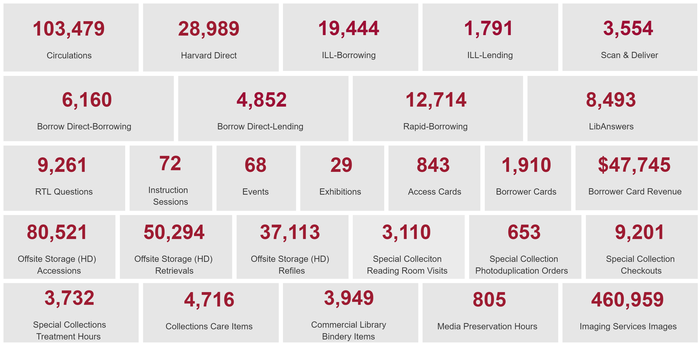
Operational Statistics
15+ people.
25+ libraries/units.
60+ data points.
10+ data sources.

Slide 15
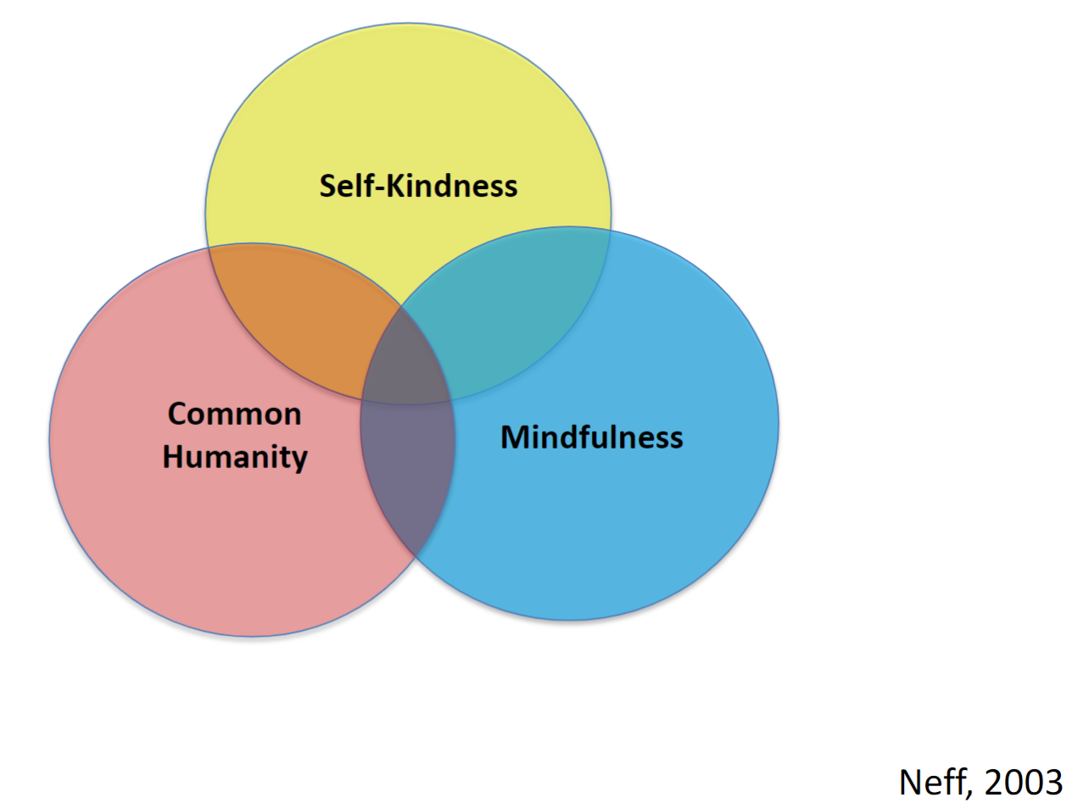
Mindful Self-Compassion at Harvard Library
Library collaborators.
University collaborators.
Community collaborators.
International collaborators.

Slide 16
Thank you

