Slide 1
HathiTrust: Focusing Collections and Collective Work
Mike Furlough, HathiTrust
5 December 2019
Harvard University Libraries
Notes:
APPRECIATIVE AND THANKFUL NOISES

Slide 2
This morning’s discussion
What is HathiTrust: history and the organization
What does membership mean: services and engagement
What collections do we steward: with a focus on Harvard’s contributions
What challenges are we addressing: preservation, rights, and research
What work will we be focused on: some current emphases
Notes:
Goal – help demystify HathiTrust – more than a digital library
A digital library in service of focusing collective work for common good resources

Slide 3
Notes:
Recently Google released this video commemorating the 15th anniversary of it’s Library Digitization Partnership program.
Hard to believe that it was in December 2004 (NYTIMES: DECEMBER 14) that this audacious project was launched, which in turn launched a great deal of excitement, enthusiasm, anxiety, criticcim, lawsuits, conspiracy theories, and excitement.
Grew from five libraries to dozens around the world.
Today, after legal drama has been settled and mass digitization has been, at least in the US, ruled to be lawful activity that fall under exceptions to copyright, the project is almost forgotten.
But continues still, to do this day.

Slide 4
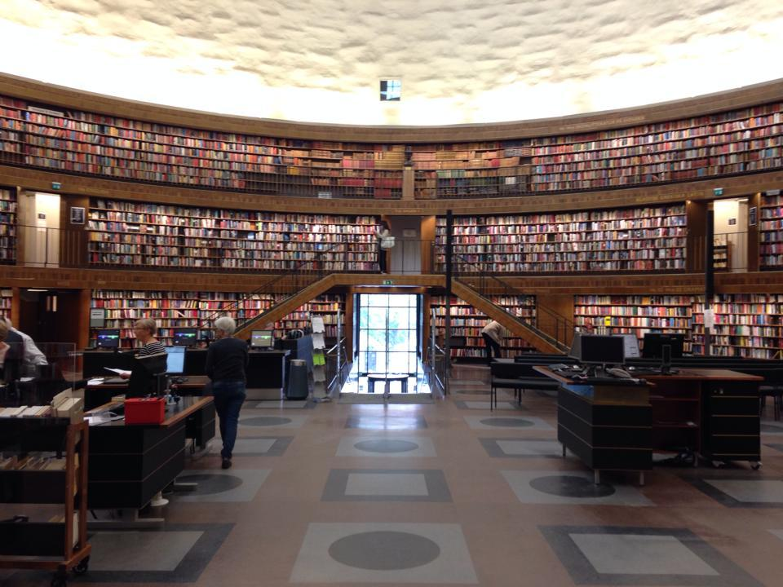
is not
Books
Notes:
From the outset, Google and its library partners had distinctive views of the project and its product.
I often generalize this to say Google was focused primarily on the libraries’ collections as (potential) data -- content to be mined for indexing, search, and over time, AI
Libraries understood that collections could be data. But also knew that academic users – as opposed to general public users of search -- were unique, highly differentiated, and that these digital surrogates should continue to be related back to their physical counterparts to ensure the preservation of the collections. Preservation and access must be linked.
Libraries tenacious in securing access to scans, rights to reused in academic/research contexts,` to improvements in the quality of scans, to a more transparent process.
This once in generation/lifetime opportunity was an impetus for the development of HathiTrust – recognition of need to share effort to develop preservation and access infrastructure
Google’s success at supporting general users is undeniable, and we cannot match their breadth
HathiTrust’s success at supporting research and educational uses of the collection is not matched by Google at least not now.
And that extends to libraries uses of the collections as data – but data for scholarship.

Slide 5
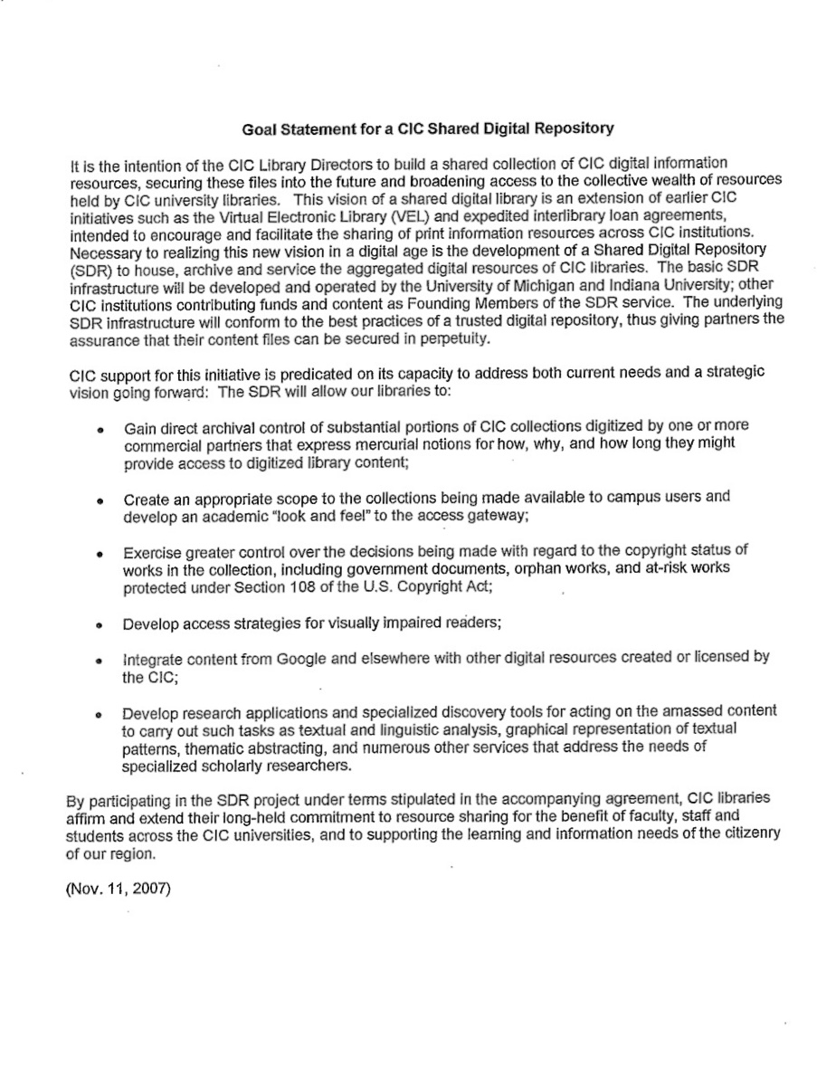
Gain direct archival control of substantial portions of CIC collections digitized by one or more commercial partners that express mercurial notions for how, why, and how long they might provide access to digitized library content;
Create an appropriate scope to the collections being made available to campus users and develop an academic "look and feel" to the access gateway;
Exercise greater control over the decisions being made with regard to the copyright status of works in the collection, including government documents, orphan works, and at-risk works protected under Section 108 of the U.S. Copyright Act;
Develop access strategies for visually impaired readers;
Integrate content from Google and elsewhere with other digital resources created or licensed by the CIC;
Develop research applications and specialized discovery tools for acting on the amassed content to carry out such tasks...that address the needs of specialized scholarly researchers.
Preface from the Original “Memorandum of Agreement on Collaborative Principles for a CIC Shared Digital Repository”
--November 2007
Notes:
Impulse for collective work – within the CIC/Big Ten led to work on SDR – led to HathiTrust.
We might have dated this from November of the year before, when the CIC schools codified their commitment to develop a Shared Digital Repository.
Their goals for this project, which eventually became HathiTrust, are still instrumental to our work today.
IMAGE SOURCE: Page scan of “Memorandum of Agreement on Collaborative Principles for a CIC Shared Digital Repository” November 11, 2007. Document held in HathiTrust administrative files.
THIS SLIDE CONTAINS ANIMATION – THE IMAGE CAN BE VIEWED IN SLIDESHOW VIEW – ADVANCING THE SLIDE WILL SHOW THE TEXT, WHICH IS QUOTED BELOW
========
Quotes from original document:
Gain direct archival control of substantial portions of CIC collections digitized by one or more commercial partners that express mercurial notions for how, why, and how long they might provide access to digitized library content;
Create an appropriate scope to the collections being made available to campus users and develop an academic "look and feel" to the access gateway;
Exercise greater control over the decisions being made with regard to the copyright status of works in the collection, including government documents, orphan works, and at-risk works protected under Section 108 of the U.S. Copyright Act;
Develop access strategies for visually impaired readers;
Integrate content from Google and elsewhere with other digital resources created or licensed by the CIC;
Develop research applications and specialized discovery tools for acting on the amassed content to carry out such tasks as textual and linguistic analysis, graphical representation of textual patterns, thematic abstracting, and numerous other services that address the needs of specialized scholarly researchers.

Slide 6
Analytics and TDM
Collection Management
Discovery & Access
Rights Management
Preservation
The HathiTrust Collection
Notes:
HathiTrust founded in 2008 – Big Ten joined by California –
Harvard joined in 2011
Portfolio view of HT activity

Slide 7
Mission and Vision
 | HathiTrust contributes to research, scholarship, and the common good by collaboratively collecting, organizing, preserving, communicating, and sharing the record of human knowledge.
 | Over the next five years HathiTrust will be a vital catalyst for emerging forms of research, teaching, and learning that engage the scholarly and cultural record.
Notes:
Thus, the Strategic Directions for 2019-2023 which we have completed and published this year reaffirm that we are still heading where we want to head; it was an alignment check.
Remain focused on book-like things and text, but a subtle difference emerged in the conversations. And that is articulated in the vision statement.
Mission: no change library aligned
Vision: why do we collect this material anyway?
For the coming years, we’ll organize our work around three themes -- here I’ll take a brief walk through these themes with some information on how we are beginning to work on this in 2019.

Slide 8
Membership

Slide 9
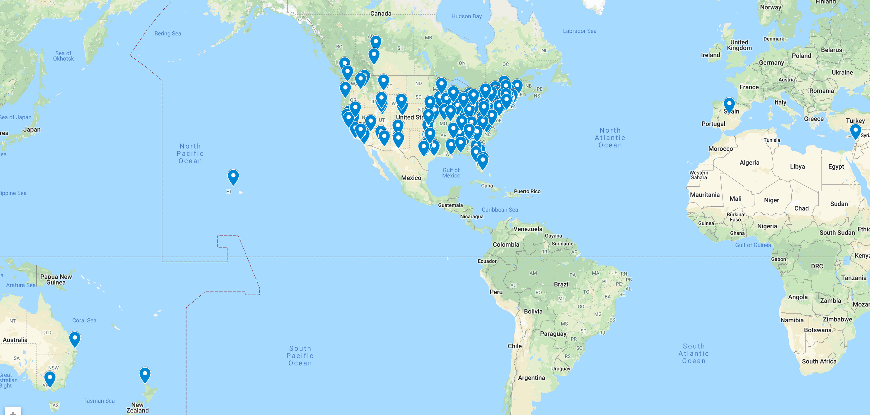
HathiTrust Members November 2019
Notes:
Just as collection remains largely focused on NA collections, so too does the membership.
Fully member funded supported – annual costs sufficient for recurring work, future strategic investments, and capital infrastructure refreshment

Slide 10
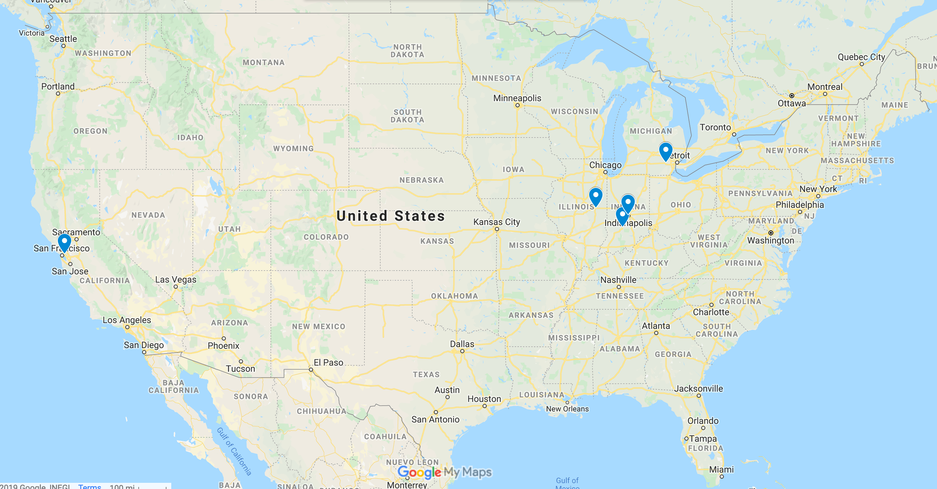
HathiTrust Enterprise Hosts
University of Michigan -- digital library and admin
University of Illinois – Research Center
Indiana University – Research Center
California Digital Library – (zephir) metadata management
Notes:
Fully member supported – and not only through cost sharing in the form of annual fees.
Members contribute effort in a variety of ways – copyright review is done by 48 different staff contributing effort from member libraries.
We also rely on co-investments made by members to operate HathiTrust’s services and infrastructure.
Admin, preservation, digital library etc at U of M – which led the founding.
Metadata services from California Digital Library – one of the founds of HT.
HathiTrust Research Center is based at IU and UI.
Services hosted are paid for in part by fees paid by all 150 members AND with in-kind co-investments made by Illinois, Inidana Michigan and California.
Deep support for HT development at each of these instittions, and in case of HTRC it goes deeper than the library, into VPR, CIO, provosts.

Slide 11
Contributed Effort: Programs
Activity | Current Participants | Focus
User Support Working Group | 28 individuals from 22 members. (51 individuals from 35 members since 2011) | Triage and respond to 4,000 email inquiries each year.
Distributed Copyright Review | 50 individuals from 31 members. (150+ persons from over 45 members since 2008) | 800,000+ reviews resulting in over 480,000+ public domain items.
Shared Print Program | 79 member libraries | Agreed to retain 18 million volumes that match 5.4 million monograph titles for 25 years.
Notes:
[17] Contributed Effort
THERE ARE OTHER WAYS THAT MEMBERS CAN CONTRIBUTE EFFORT, TIME, LABOR
User Support Working Group
Front line of public individual support
Triage and respond to 4,000 email inquiries each year.
Most of these come from individuals and most from non-members
We learn a lot from these inquiries, help us find ways to improve services
How do we manage to do that:
28 individuals from 22 members.
51 individuals from 35 members since 2011
Spend some days per year being the front line
Many questions referred to staff
Distributed Copyright Review
Copyright status is ambiguous for many items in the collection
Copyright term varies nation to nation
Distributed Copyright Review is a program that allows us to look at individual volumes, and research their copyright status, and make a determination about whether or not it is in copyright, and thus whether or not it will be open to the public for reading.
Ten years of work
700,000 reviews resulting in over 375,000 public domain items.
50 individuals from 31 members, spending about 3-6 hours of work time per week.
~25 reviews per hour.
150+ persons from over 45 members since 2008
Shared Print Program
Problem: large amounts of duplication across hundreds of libraries in North America;
Digitization creates an opportunity for libraries to make more rational collection decisions.
OCLC has published a number of excellent reports about the opportunities and needs for large scale, continental collection management.
49 libraries participate (so far) in our shared print programs,
Committed to retain for 25 years
16.1 million volumes retained in print
Corresponding to 4.8 million book titles in HathiTrust.
Plans to continue with this.
Impacts are not just retention and efficiency, but improving our knowledge of the collective collection and using that help ensure long term preservation of the print record.

Slide 12
Participation opportunities
Task Force to Develop a Statement of Values and Code of Conduct for HathiTrust (SVCC) — open now
Member Meeting Program Committee – January
Program Steering Committee – April
Soon to be appointed
Digital Collections Strategy Working Group
Metadata Sharing Task Force
Community Metadata Strategy Task Force
User Engagement Task Force

Slide 13
Member services
Long-term preservation and access for their digital collections
Unlimited deposits for collection materials
No additional costs
Download of complete works (public domain/open access)
Non-members: reading access only, page download
Special access to users who are blind and/or print-disabled
Guaranteed physical access to items retained in shared print program
Preferred/exclusive access to HathiTrust Research Center services
Opportunity to shape HathiTrust’s direction through governance
Notes:
[13] Expectations of members
Our members expect a lot from HathiTrust
But HathiTrust is only as strong as the members help it to be.
We have few requirements of members, but we encourage more activity.
Required:
Fees
Submission of metadata about the physical holdings of their collections
Encouraged —
Defined as Benefits of Membership
These behaviors make the organization stronger.
Trying to create options for members to contribute in ways that match the capacity (staffing, budget, etc) of the member.
Participation
Working groups, programs, services, etc.
Deposit
There are requirements for materials deposited

Slide 14
“HathiTrust helps your library scale, no matter your size…”

Slide 15
Collections

Slide 16
HathiTrust -- by the numbers
17.1 million total volumes
8.8 million titles
6.6 million vols (38%) open for reading (public domain & CC-licensed)
6 billion pages
~2.5 trillion words indexed / tokens computable
The collection includes (mostly) published materials in bound form,
(mostly) digitized from library collections.

Slide 17
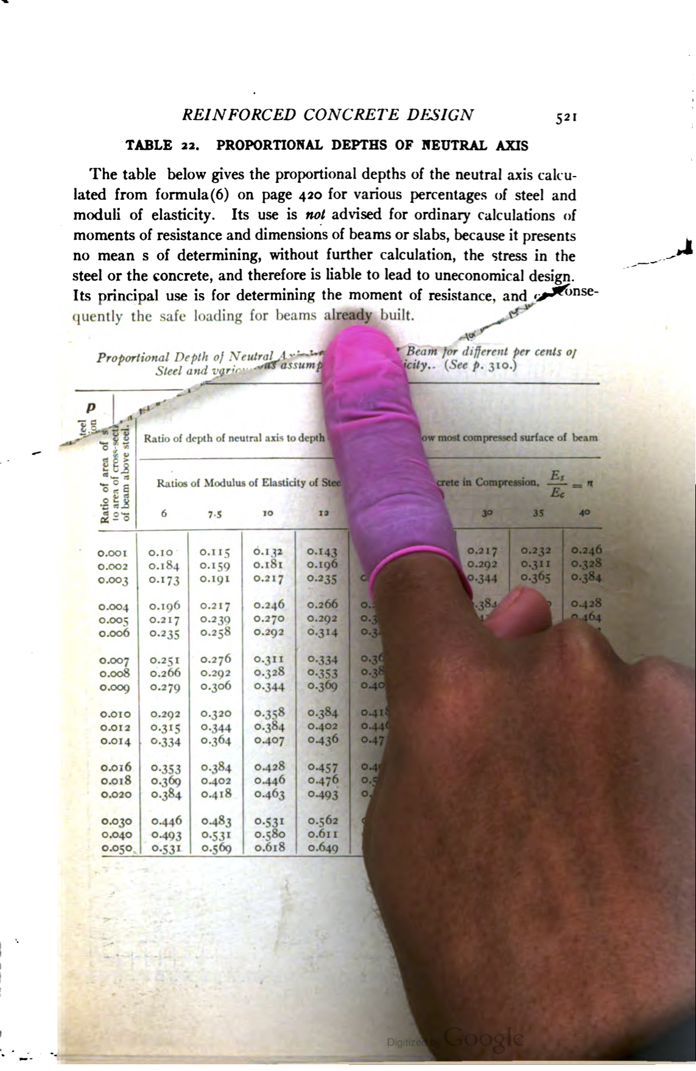
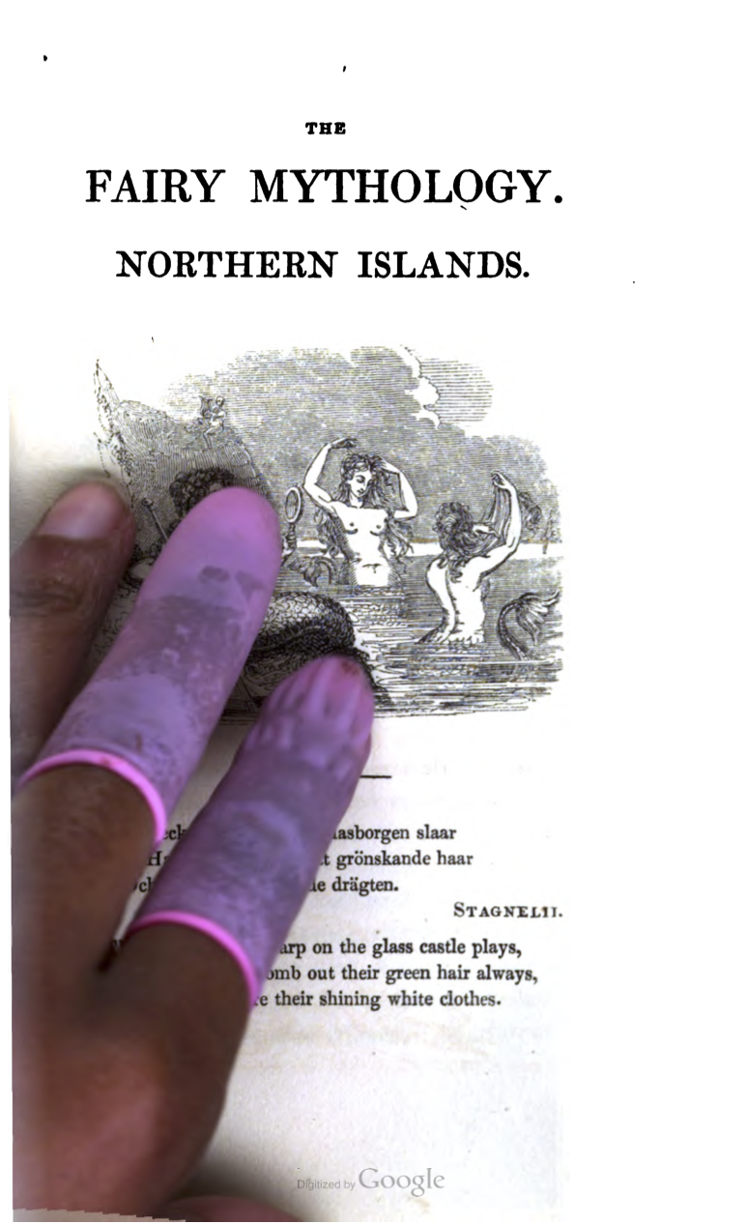
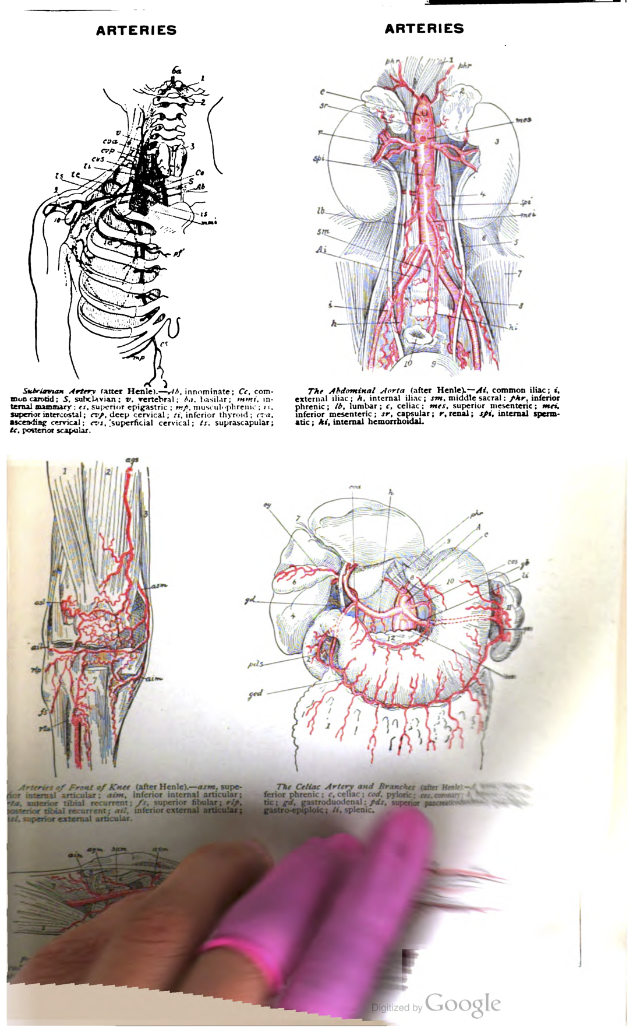
3+ billion page turns by thousands of scanning staff
Notes:
And: the scanning technicians deserve the credit. When we see their hands in a scan we may first think “human error” but these are the tangible traces we have of the thousands of people who have built these collections, page by page by billions of pages.
IMAGE SOURCES
All via Art of Google Books website (http://theartofgooglebooks.tumblr.com/) Accessed October 25, 2018
Left: Cited as From p. 521 of A Treatise on Concrete, Plain and Reinforced: Materials, Construction and Design of Concrete and Reinforced Concrete, 2nd ed., by Fredrick W. Taylor and Sanford E. Thompson. Original from the University of Wisconsin - Madison. Digitized January 7, 2008.
Center: Cited as From p. 245 of The Fairy Mythology: Illustrative of the Romance and Superstition of Various Countries, v. 1, by Thomas Keightley (1833). Original from the New York Public Library. Digitized June 20, 2006.
Right: Cited as From p. 104 of The American Medical Illustrated Dictionary by William Alexander Newman Dorland (1915). Original from Harvard University. Digitized May 30, 2008.

Slide 18
Titles by Language
Notes:
Updated 7/1/2018

Slide 19
Notes:
Updated 10/31/2017 This data changes very little over time and thus has not been updated recently. The most recent data on is always available at https://www.hathitrust.org/statistics_visualizations.

Slide 20
**excluding paywalled publisher products
Notes:
The collection we hold is substantial – and it represents a large portion of what has been generated through mass book digitization programs – Google, IA, Microsoft
Largely representative of North American mass digitization, less so of Europe, Asia

Slide 22
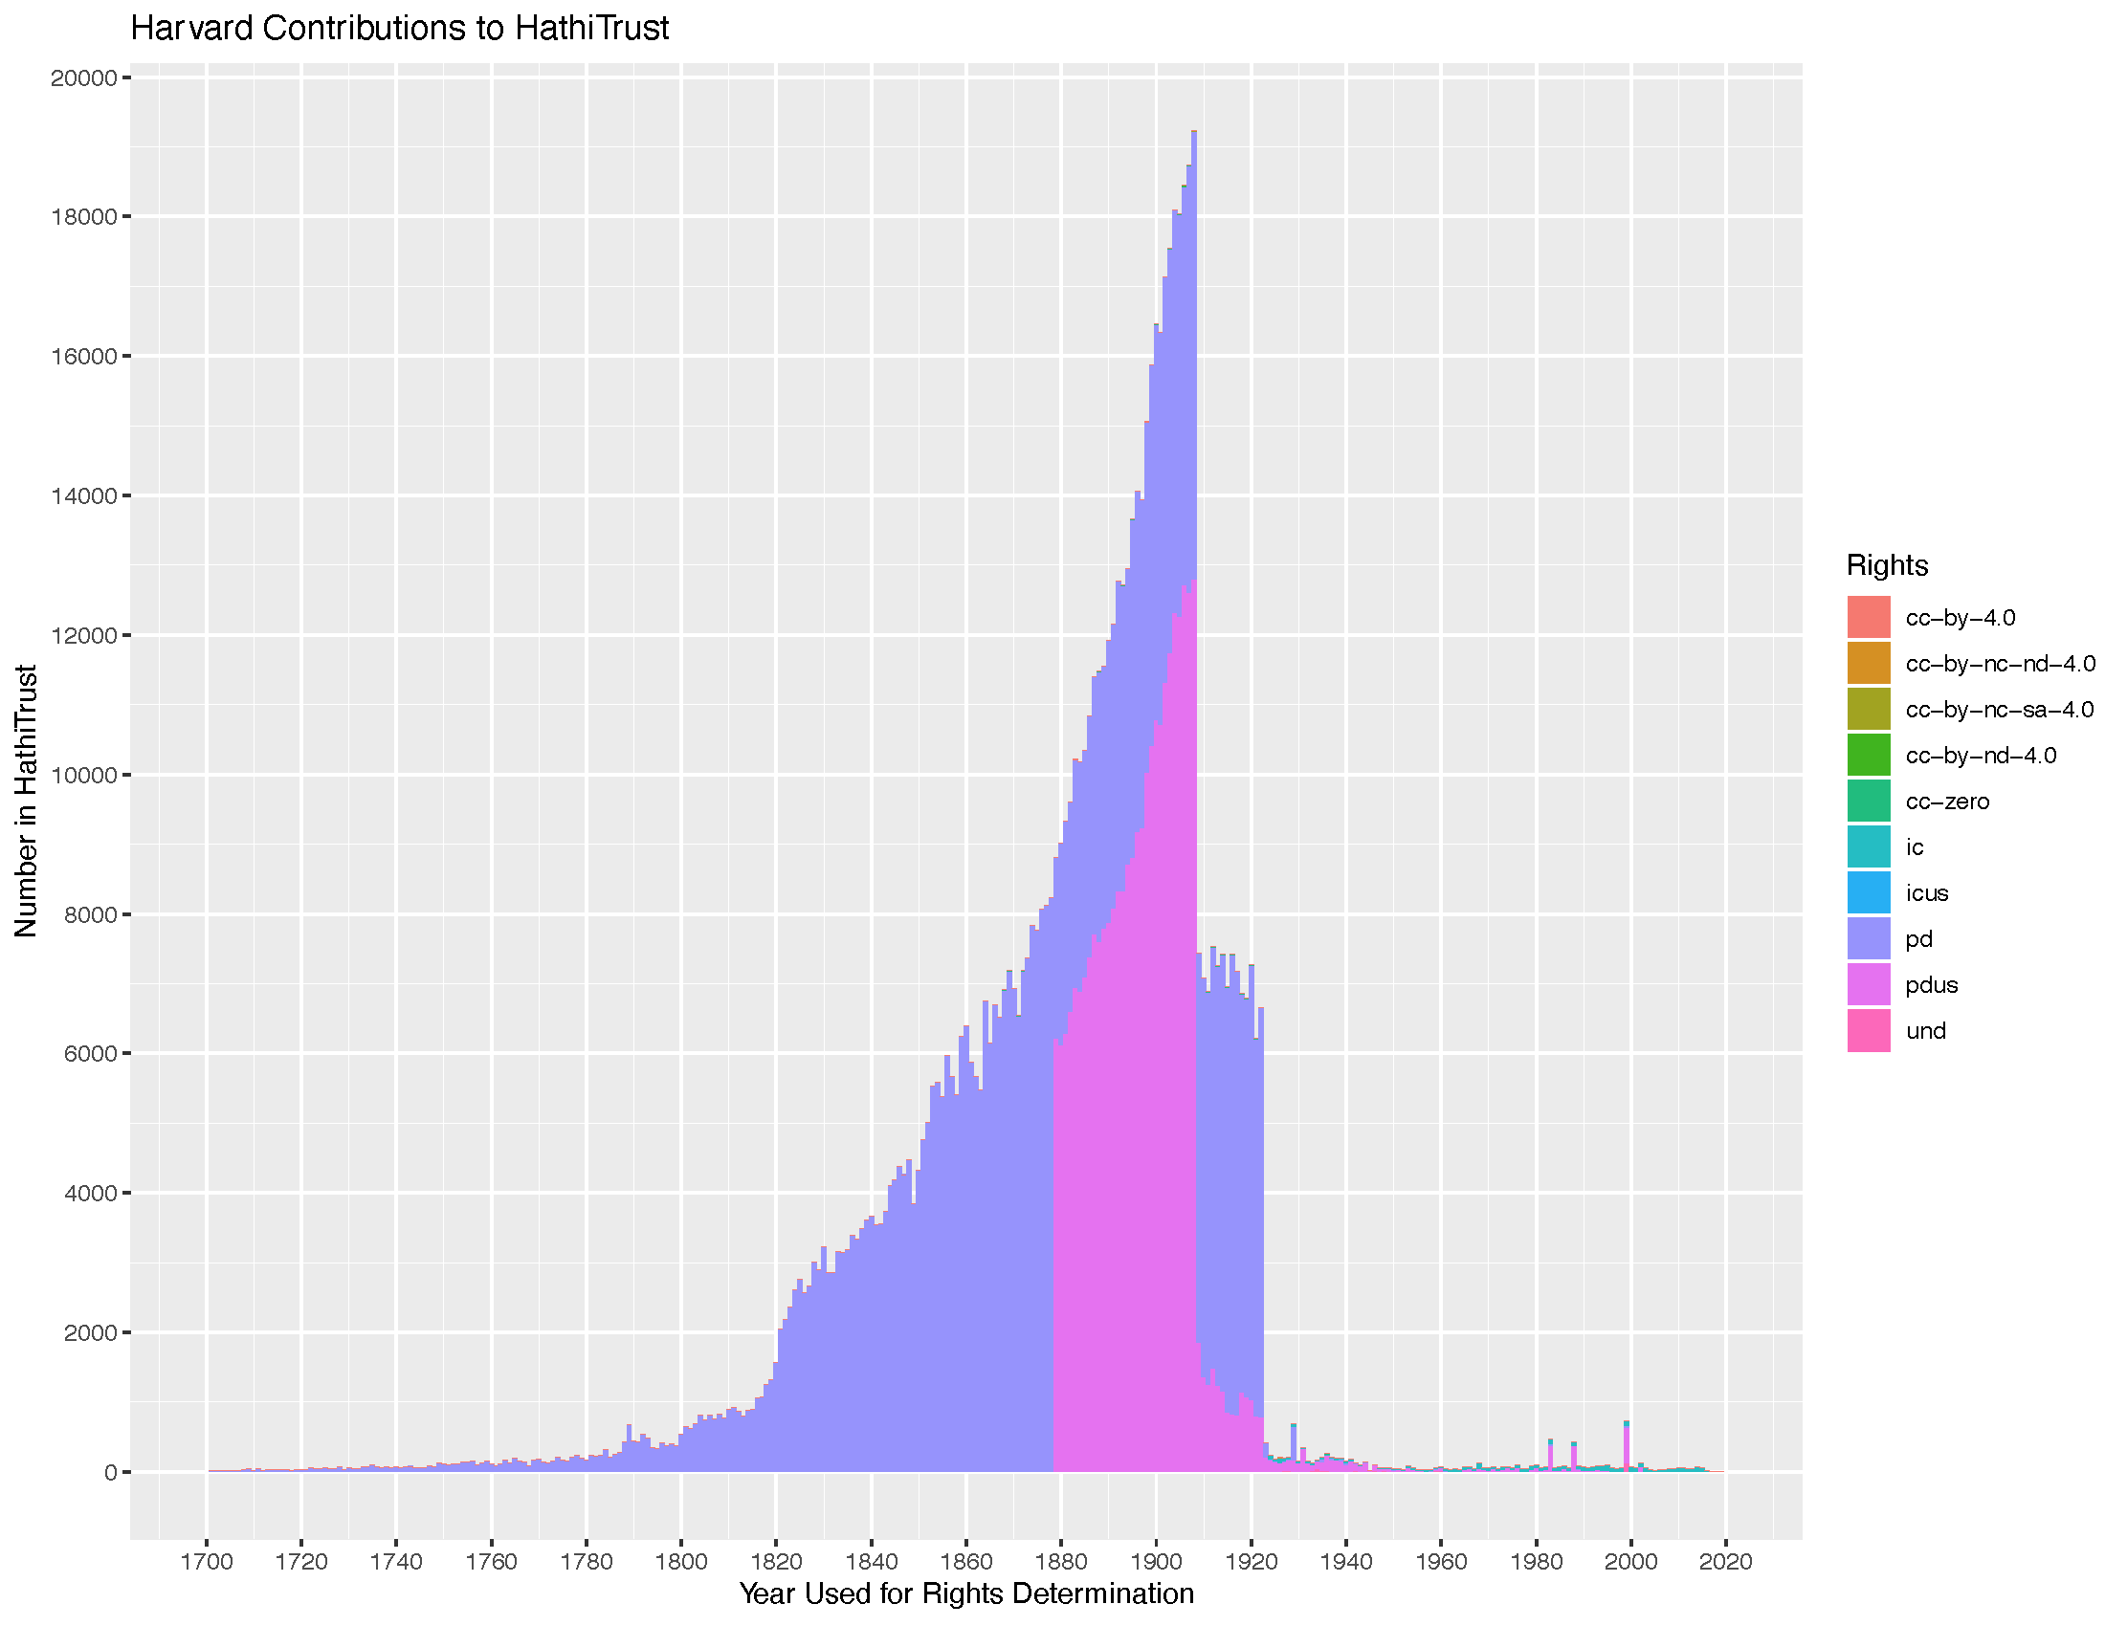
Notes:
This slide shows Harvard deposits by rights status – almost entirely public domain worldwide or public domain in US.

Slide 23
Notes:
The red rectangle = roughly the same area shown on previous slide.

Slide 24
Notes:
Most recent data at https://www.hathitrust.org/visualizations_deposited_volumes_current

Slide 25
Notes:
Ivy Plus deposits, based on data at https://www.hathitrust.org/visualizations_deposited_volumes_current

Slide 26
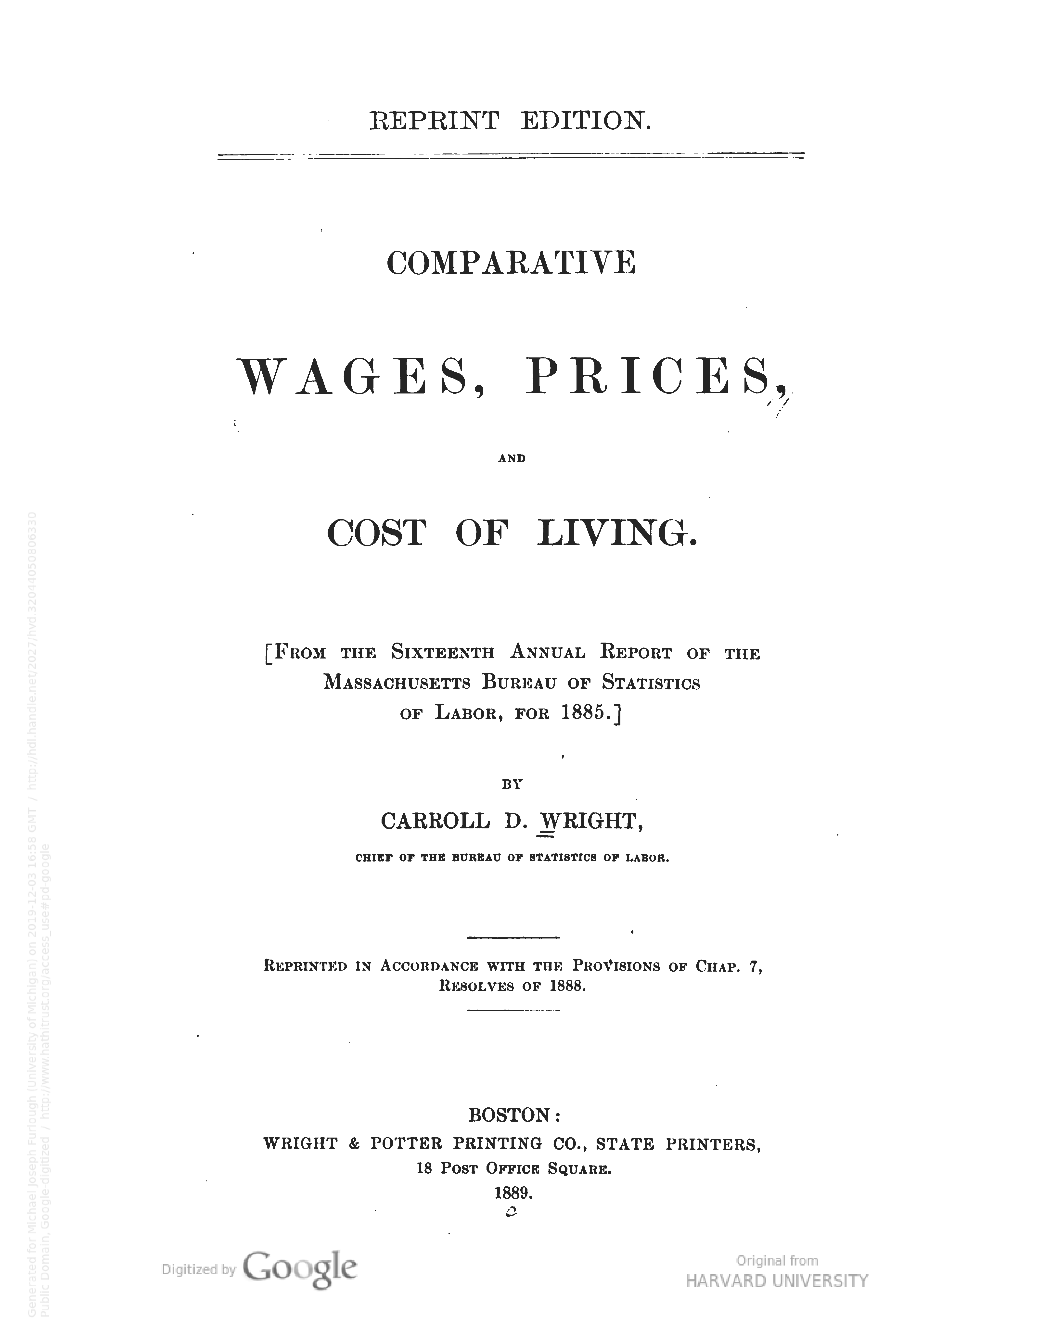
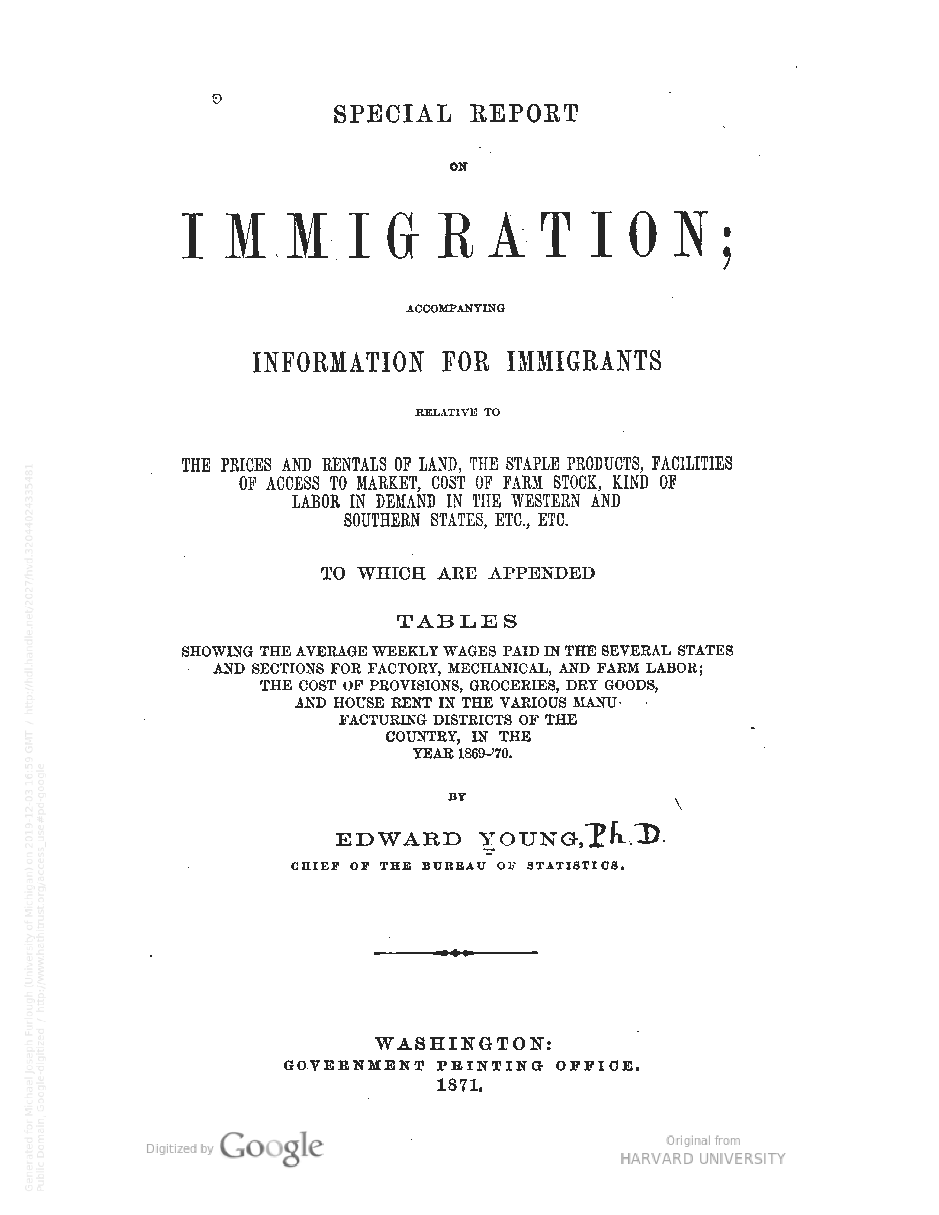
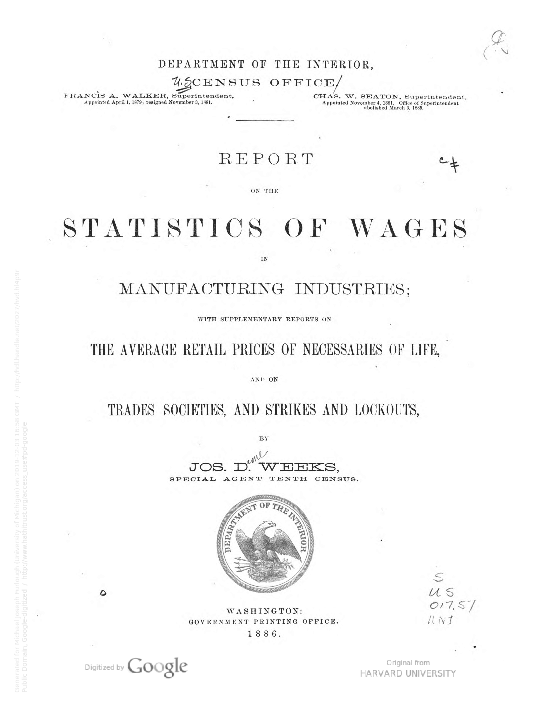
Items from Harvard’s collection were viewed almost 20 million times in the past 12 months.
The three most-frequently viewed items from Harvard’s collection are shown above.
Notes:
Comparative wages, prices, and cost of living : (from the Sixteenth annual report of the Massachusetts Bureau of Statistics of Labor, for 1885) /by Carroll D. Wright. https://hdl.handle.net/2027/hvd.32044050806330
Special report on immigration : accompanying information for immigrants relative to the prices and rentals of land, the staple products, facilities of access to market, cost of farm stock, kind of labor in demand in the western and southern states, etc., etc., to which are appended tables showing the average weekly wages paid in the several states and sections for factory, mechanical, and farm labor, the cost of provisions, groceries, dry goods, and house rent in the various manufacturing districts of the country, in the year 1869-'70 / by Edward Young, chief of the Bureau of Statistics. https://hdl.handle.net/2027/hvd.32044024335481
Report on the statistics of wages in manufacturing industries : with supplementary reports on the average retail prices of necessaries of life, and on trades societies, and strikes and lockouts / by Jos. D. Weeks. https://hdl.handle.net/2027/hvd.hl4p9r

Slide 27
Collective Challenges
Notes:
HT does not support collective work in the sense of an open source project like Fedora, Dspace or Samvera.
We have actually focused more on centralizing infrastructure so that the collection is a focal point of coordinated work across membership/for membership
Collection as an end in itself – yes
But more than that….

Slide 28
Analytics and TDM
Collection Management
Discovery & Access
Rights Management
Preservation
The HathiTrust Collection

Slide 29
Collective Action: Copyright Review
Copyright Review Management System
Systematic manual review of copyright registrations to determine status of portions of the HathiTrust Collection, Supported generously by IMLS
WINNER OF THE 2016 L RAY PATTERSON AWARD
Project | Reviewed | Out of Copyright
US State Gov Docs 1923-1977 | 119,928 | 101,629 (84.7%)
US Monographs 1923-1963 | 407,193 | 215,745 (52.9%)
UK, Canada, Australia 1875-1948/68 | 307,875 | 162,860 (52.8%)
Notes:
Crown Copyright Materials: new project looking at materials that held/hold crown copyright in UK and other (former) commonwealth nations. Small number of candidates, reviewers recruited from Canada and Australia

Slide 30
US Federal Documents Program
Focus:
expanded coverage & enhanced access to U.S. federal documents.
Near term activities:
Developing a registry of US Federal Government Documents
https://www.hathitrust.org/usdocs_registry
Digitize! Focus first on known and cataloged materials
Gap analysis driven, focused on print, post-1976 materials
Improve discoverability/findability of collection
https://is.gd/HathiFedDocs
Notes:
GAP analysis focusing on these agencies/sets:
Acquire comprehensive runs of essential titles:
Congressional Serial Set
Congressional Record [bound]
Statistical Abstract of the United States
Economic Report of the President
Foreign Relations of the United States
United States Reports
Large statistical yearbooks, such as Agricultural Statistics, etc.
Agency annual reports
All hearings
Acquire key agencies:
EPA
NOAA
NASA
Central Intelligence Agency
Bureau of Indian Affairs
Acquire agencies within:
Department of Transportation
Department of the Interior
Department of Agriculture

Slide 31
Shared Print Program
Link preservation of print and digital collections
Catalyze national/continental collective management of collections
25 year commitments to retain print holdings that mirror book titles in the HathiTrust digital collection
Phase 1 & 2 accomplishments:
79 libraries
18 million volumes
5.4 million titles
Harvard has committed 771,712 titles as part of this program
Notes:
As of January 2018, the North American collective print book collection included 56.2 million distinct print book publications, and accounted for 987.4 million holdings in library collections across the United States and Canada.
--unpublished report from OCLC Research

Slide 32
Support Avenues
Regional training and workshops
Virtual help: online office hours
Advanced Collaborative Support (ACS) program
https://analytics.hathitrust.org/
Notes:
Workshops: https://www.hathitrust.org/htrc_workshops
Advanced Collaborative Support most recent call for proposals (spring 2019): https://www.hathitrust.org/htrc_sp19acs_rfp
Most recently awarded projects: https://www.hathitrust.org/hathitrust-research-center-awards-five-acs-projects
ORIGINAL GOALS
From RFP
“….provide opportunities for investigation and scholarship in areas, and on a scale, that have not previously been available.”
“…. the surge in digital humanities computing projects in recent years.”
From Proposal by Indiana and Illinois
“…. Support innovation in cyberinfrastructure…in delivering efficient access to copyrighted material that preserves and shapes the restriction of ‘non-consumptive research’.”
“… enhance the value of HathiTrust through additional integration indexes and analysis tools.”

Slide 33
On the horizon

Slide 34
HathiTrust empowers its member libraries and their patrons through a durable, sustainable, and transparent organization and open infrastructure.
HathiTrust bolsters content discovery and diversifies uses of the scholarly record through services that improve the quality of the collection and the user experience.
HathiTrust addresses significant challenges libraries cannot independently confront to advance innovative forms of research, pedagogy, and public engagement.

Slide 35
Focus
In the second year of our strategic plan we will drill down more deeply to define the future we want.
Collection Strategies that Drive Long-term Value
Infrastructure and Analytics to Underpin Our Work
Discovery and Delivery of the Collections
Member and User Engagement to Support Their Needs
Notes:
Purposeful, intentional change was a theme of our Strategic Planning process.
Members message: Let's focus on what is/was uniquely powerful about HathiTrust and build upon that.
Strategic Directions organized around three themes:
EMPOWER
ENHANCE
TRANSFORM

Slide 36
Thank you….
furlough@HathiTrust.org

Slide 39
The following slides were not included in my presentation. They are drawn from a recent presentation on the HathiTrust Research Center that was presented at the RLUK/TNA sponsored conference Navigating the Digital Shift in November 2019. These slides were prepared by John Walsh, the Director of the Research Center at Indiana University. I thought they might be useful to some.

Slide 40
Why a HathiTrust Research Center
From RFP
“….provide opportunities for investigation and scholarship in areas, and on a scale, that have not previously been available.”
“…. the surge in digital humanities computing projects in recent years.”
From Proposal by Indiana and Illinois
“…. Support innovation in cyberinfrastructure…in delivering efficient access to copyrighted material that preserves and shapes the restriction of ‘non-consumptive research’.”
“… enhance the value of HathiTrust through additional integration indexes and analysis tools.”
Notes:
WHY DID WE PURSUE RESEARCH CENTER
REMEMBER – FOCUS ON SPECIALIZED USES FOR ACADEMIC CONTEXTS
COMPUTATIONAL ANALYSIS UNDERSTOOD TO BE OF SIGNIFICANT POTENTIAL AND COMING WAVE
ESSENTIALLY TO TRY TO PROVIDE A LEADING EDGE SERVICE FROM ACADEMIC LIBRARIES.
OTHER FOCI:
Area of research interest at Indiana – enabling restricted access for TDM – novel ways of offering secure computing environments and the challenge of avoiding reconstructability of full text outside of the secure environment
Can we use TDM To improve quality of collection, metadata, discovery, services, etc.

Slide 41
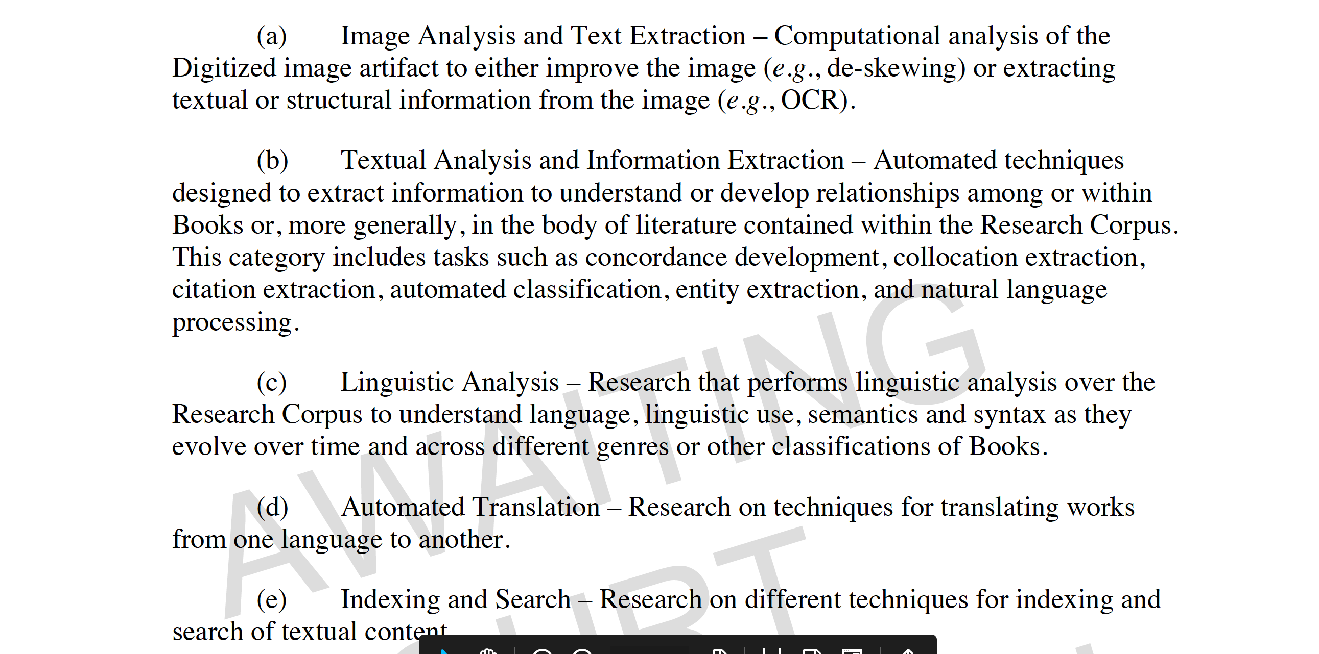
Notes:
IDEA FOR RESEARCH CENTER WAS PROMOTED IN PROPOSED COURT SETTLEMENT AMONG GOOGLE, PUBLISHERS, AUTHORS
ULTIMATELY REJECTED BY COURTS
Buried within this vast and complex settlement proposal was a legal neologisim: “non-consumptive use” -- used to describe machine-enabled analysis of collections in contrast to human reading, e.g., consumptive use.
Such non-consumptive uses would be permitted through two “research centers” at college or university in the United States that would support advanced computational analysis of the corpus it was creating.
The research centers were not understood as a distribution point, but as service centers, which provided infrastructure, technical support, and security protocols to enable onsite or remote computation. Distribution of the original content would have been severely limited under contract.
These non-consumptive uses would have been court-sanctioned and exclusively available to Google and its library/university/college partners. This is an important point: contractually TDM would have been allowed, but it would have remained ambiguous if it was statutorily permitted without contracts and licenses among parties.
once the proposed settlement failed, Google never again expressed an interest in running or directly supporting a public- or scholar-facing service on the scale of the research centers that were contemplated. EVEN THOUGH The courts LATER clarified that indexing was lawful, and indexing was what they continued to do in a public facing way. What remains of this ambition is the Google Ngram Viewer, as well as the extensive machine learning-based R&D underway within Google for its own business purposes.

Slide 42
HathiTrust Research Center Functions and Services
Notes:
Thank you, Mike. [And thank you again to the DCDC conference for this opportunity to speak to you today.]

Slide 43
HTRC Services: Web Portal
https://analytics.hathitrust.org
Extracted Features
Text Analysis Algorithms
Data Capsules
Notes:
Most HTRC services may be accessed through our Web portal at analytics.hathitrust.org. From there you can access our main user tools:
The Extracted Features dataset
Text Analysis Algorithms
Data Capsules
These services address users with different levels of text data mining experience, from novices to experts.

Slide 44
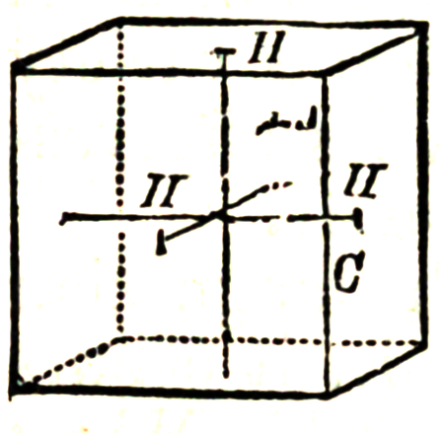
HTRC Services: Extracted Features
Downloadable, open dataset of page-level metadata and word counts for every page in the HT Digital Library;
Facts derived from the content;
Features such as word counts, part of speech tags, header and footer information, volume metadata, inferred language, etc.;
May be used for word lists/clouds, topic modeling, clustering, information extraction, etc.
Notes:
The Extracted Features dataset is a downloadable open dataset of page-level metadata and word counts for every page in the HT digital library.
The Extracted Features include facts about the text: word and punctuation counts, parts of speech, header and footer information, volume metadata, language information, etc.
These data files may be used for generating word lists and clouds, for topic modeling, information extraction, certain types of linguistic analysis, etc.
In their raw form, the Extracted Features data are probably more suited for intermediate to expert text data mining users. These JSON data files that must be parsed and manipulated for information extraction and analysis.

Slide 45
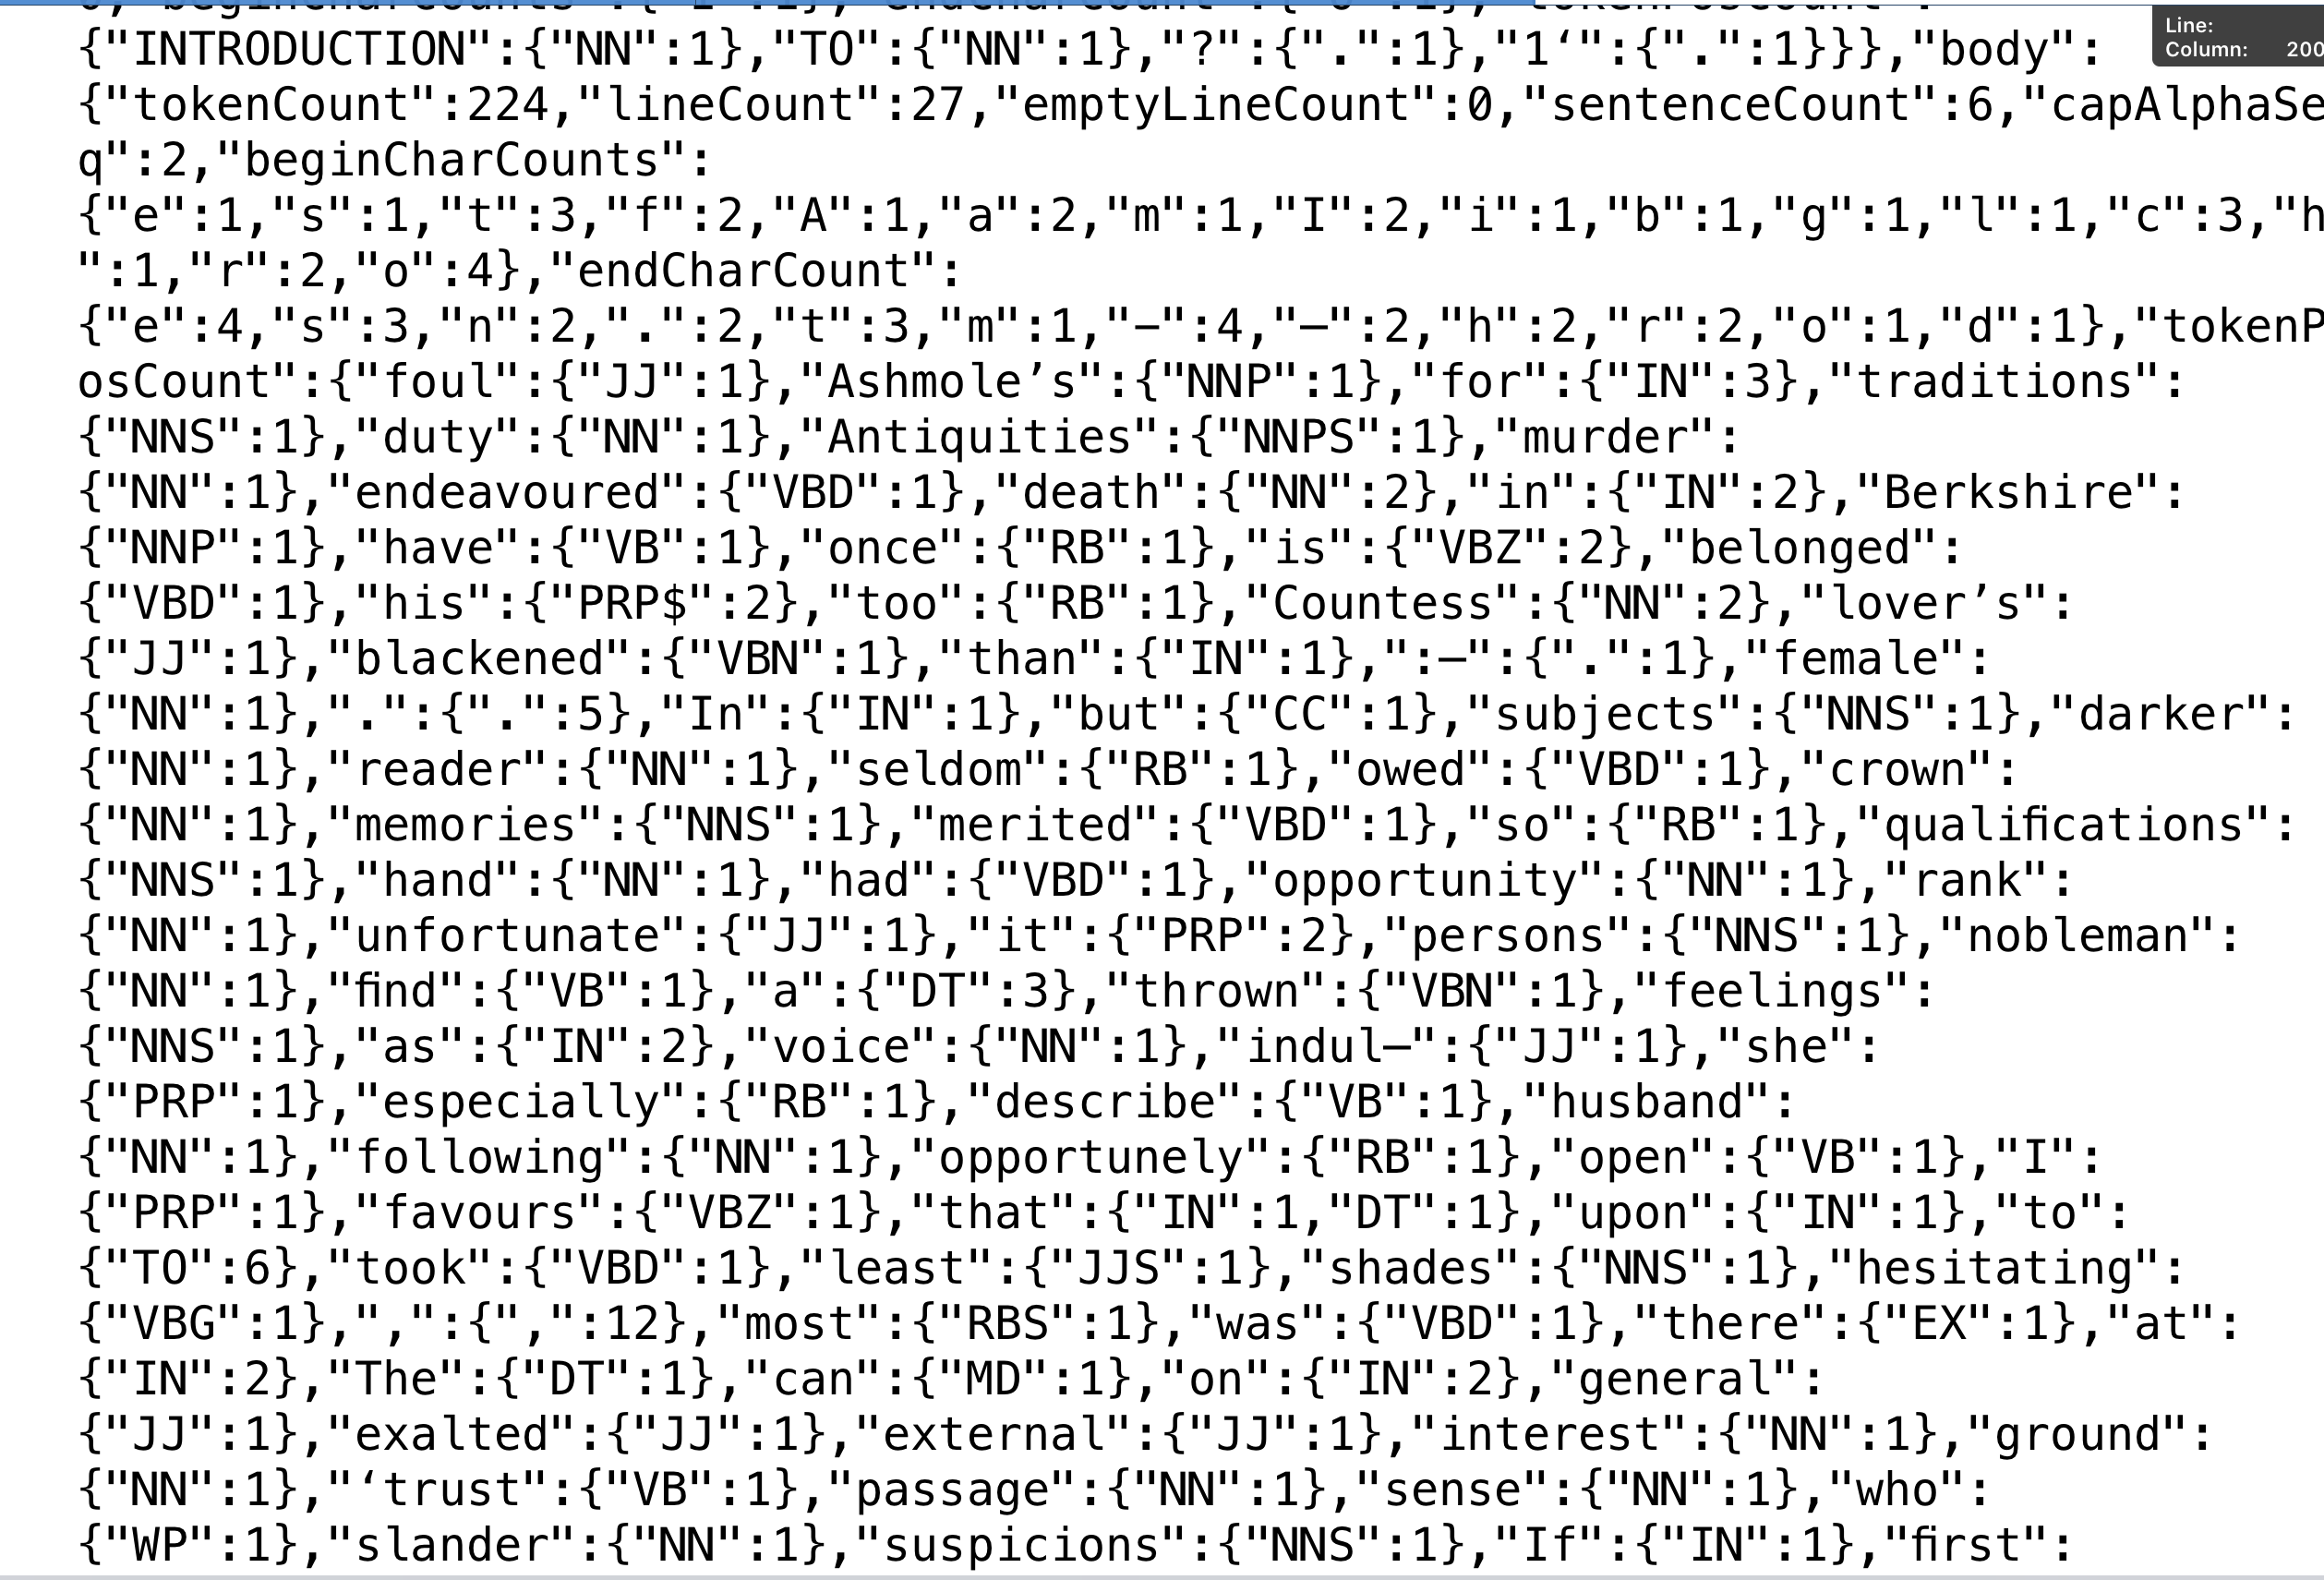
Notes:
This is what a bit of a raw EF JSON looks like.

Slide 46
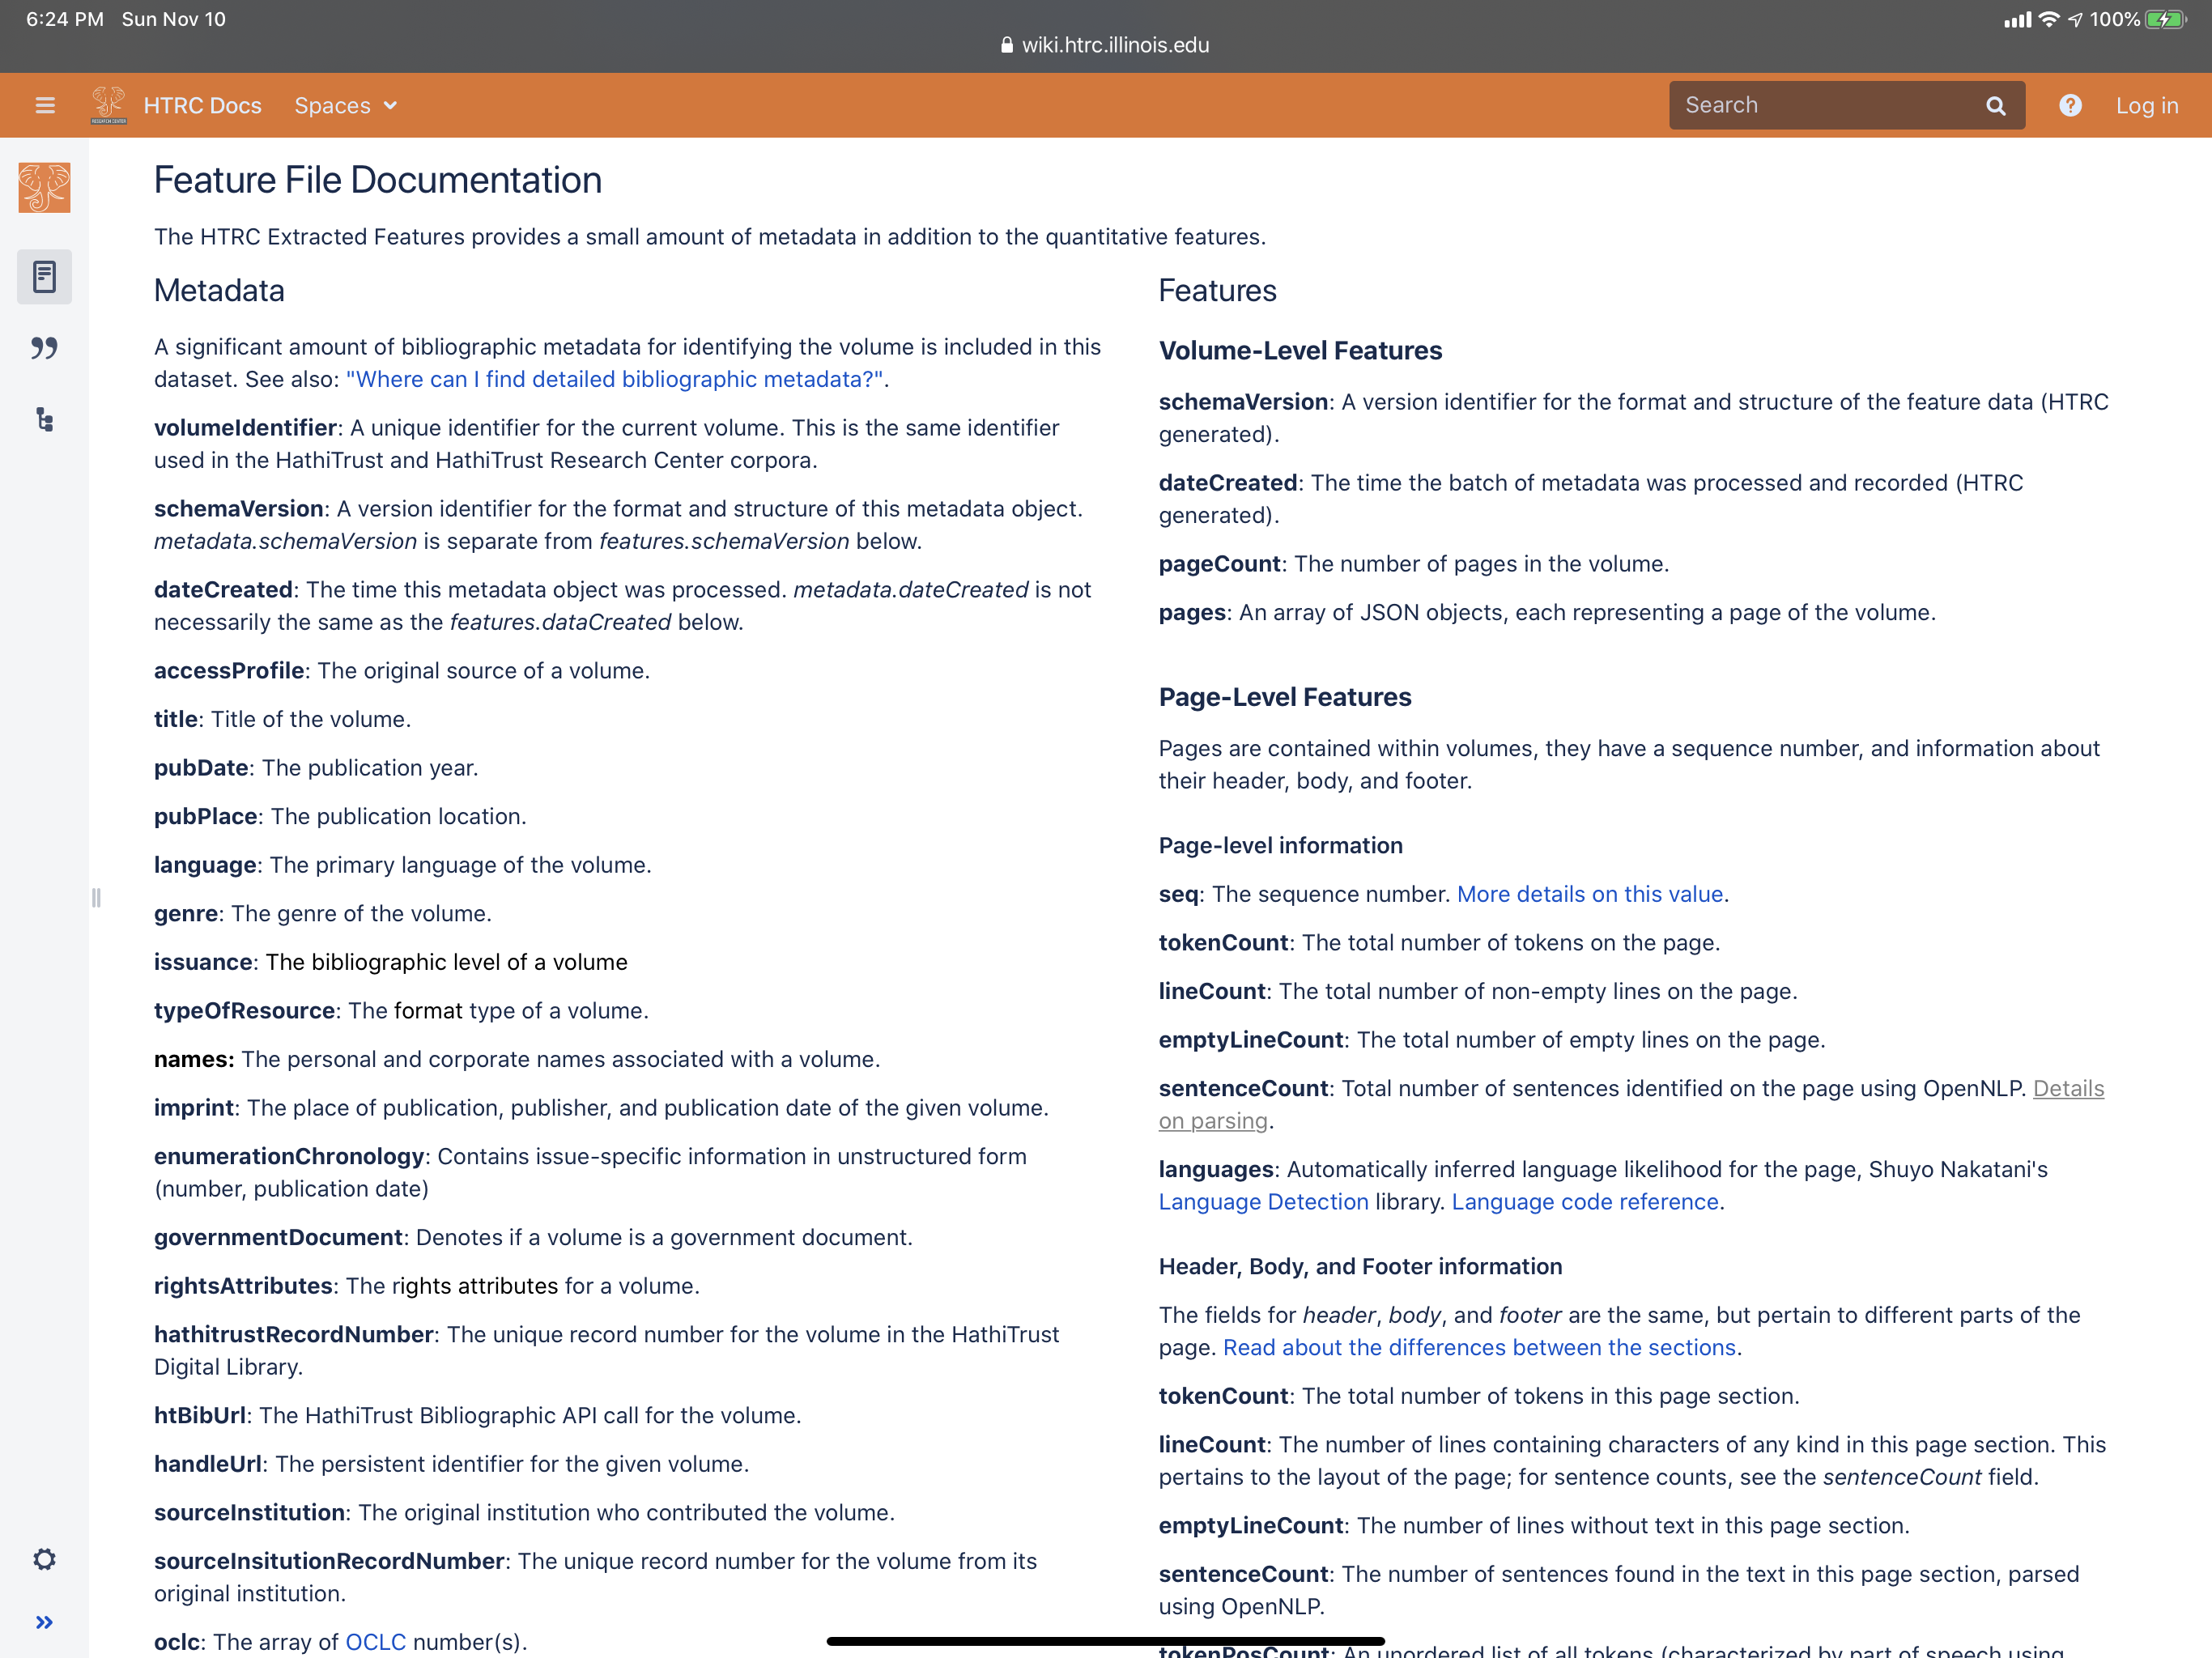
Notes:
Our online EF documentation explains all the features, or fields, available in the data set, along with acknowledgements and links to open source tools used to generate the features.
We provide a tool that allows users to download a subset of the EF data files for a particular user-created collection, or workset.

Slide 47
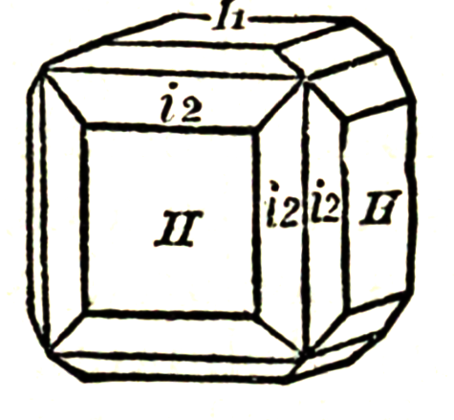
HTRC Services: Text Analysis Algorithms
Web-based click-and-run tools that perform computational text analysis on user-created collections.
Notes:
The text analysis algorithms are Web-based, click-and-run tools that perform computational text analysis on user-created collections. These are our entry-level tools for the novice user, facilitating the generation of results and visualizations through our Web interface.

Slide 48
InPhO
Topic
Explorer
Walter, Scott. Waverly Novels. 48 vols. Edinburgh: R. Cadell, 1829-1833.
Notes:
Our InPhO Topic Explorer implements the LDA [Latent Dirichlet allocation] topic modeling algorithm to produce interactive topic visualizations. It also generates downloadable files that can be used with a local install of the Topic Explorer to access the complete word-topic and topic-document matrices, along with other advanced analytics.
The corpus I'm using in these examples is the 48 volumes of Sir Walter Scott's _Waverly Novels_ published by Robert Cadell 1829-1833.

Slide 49
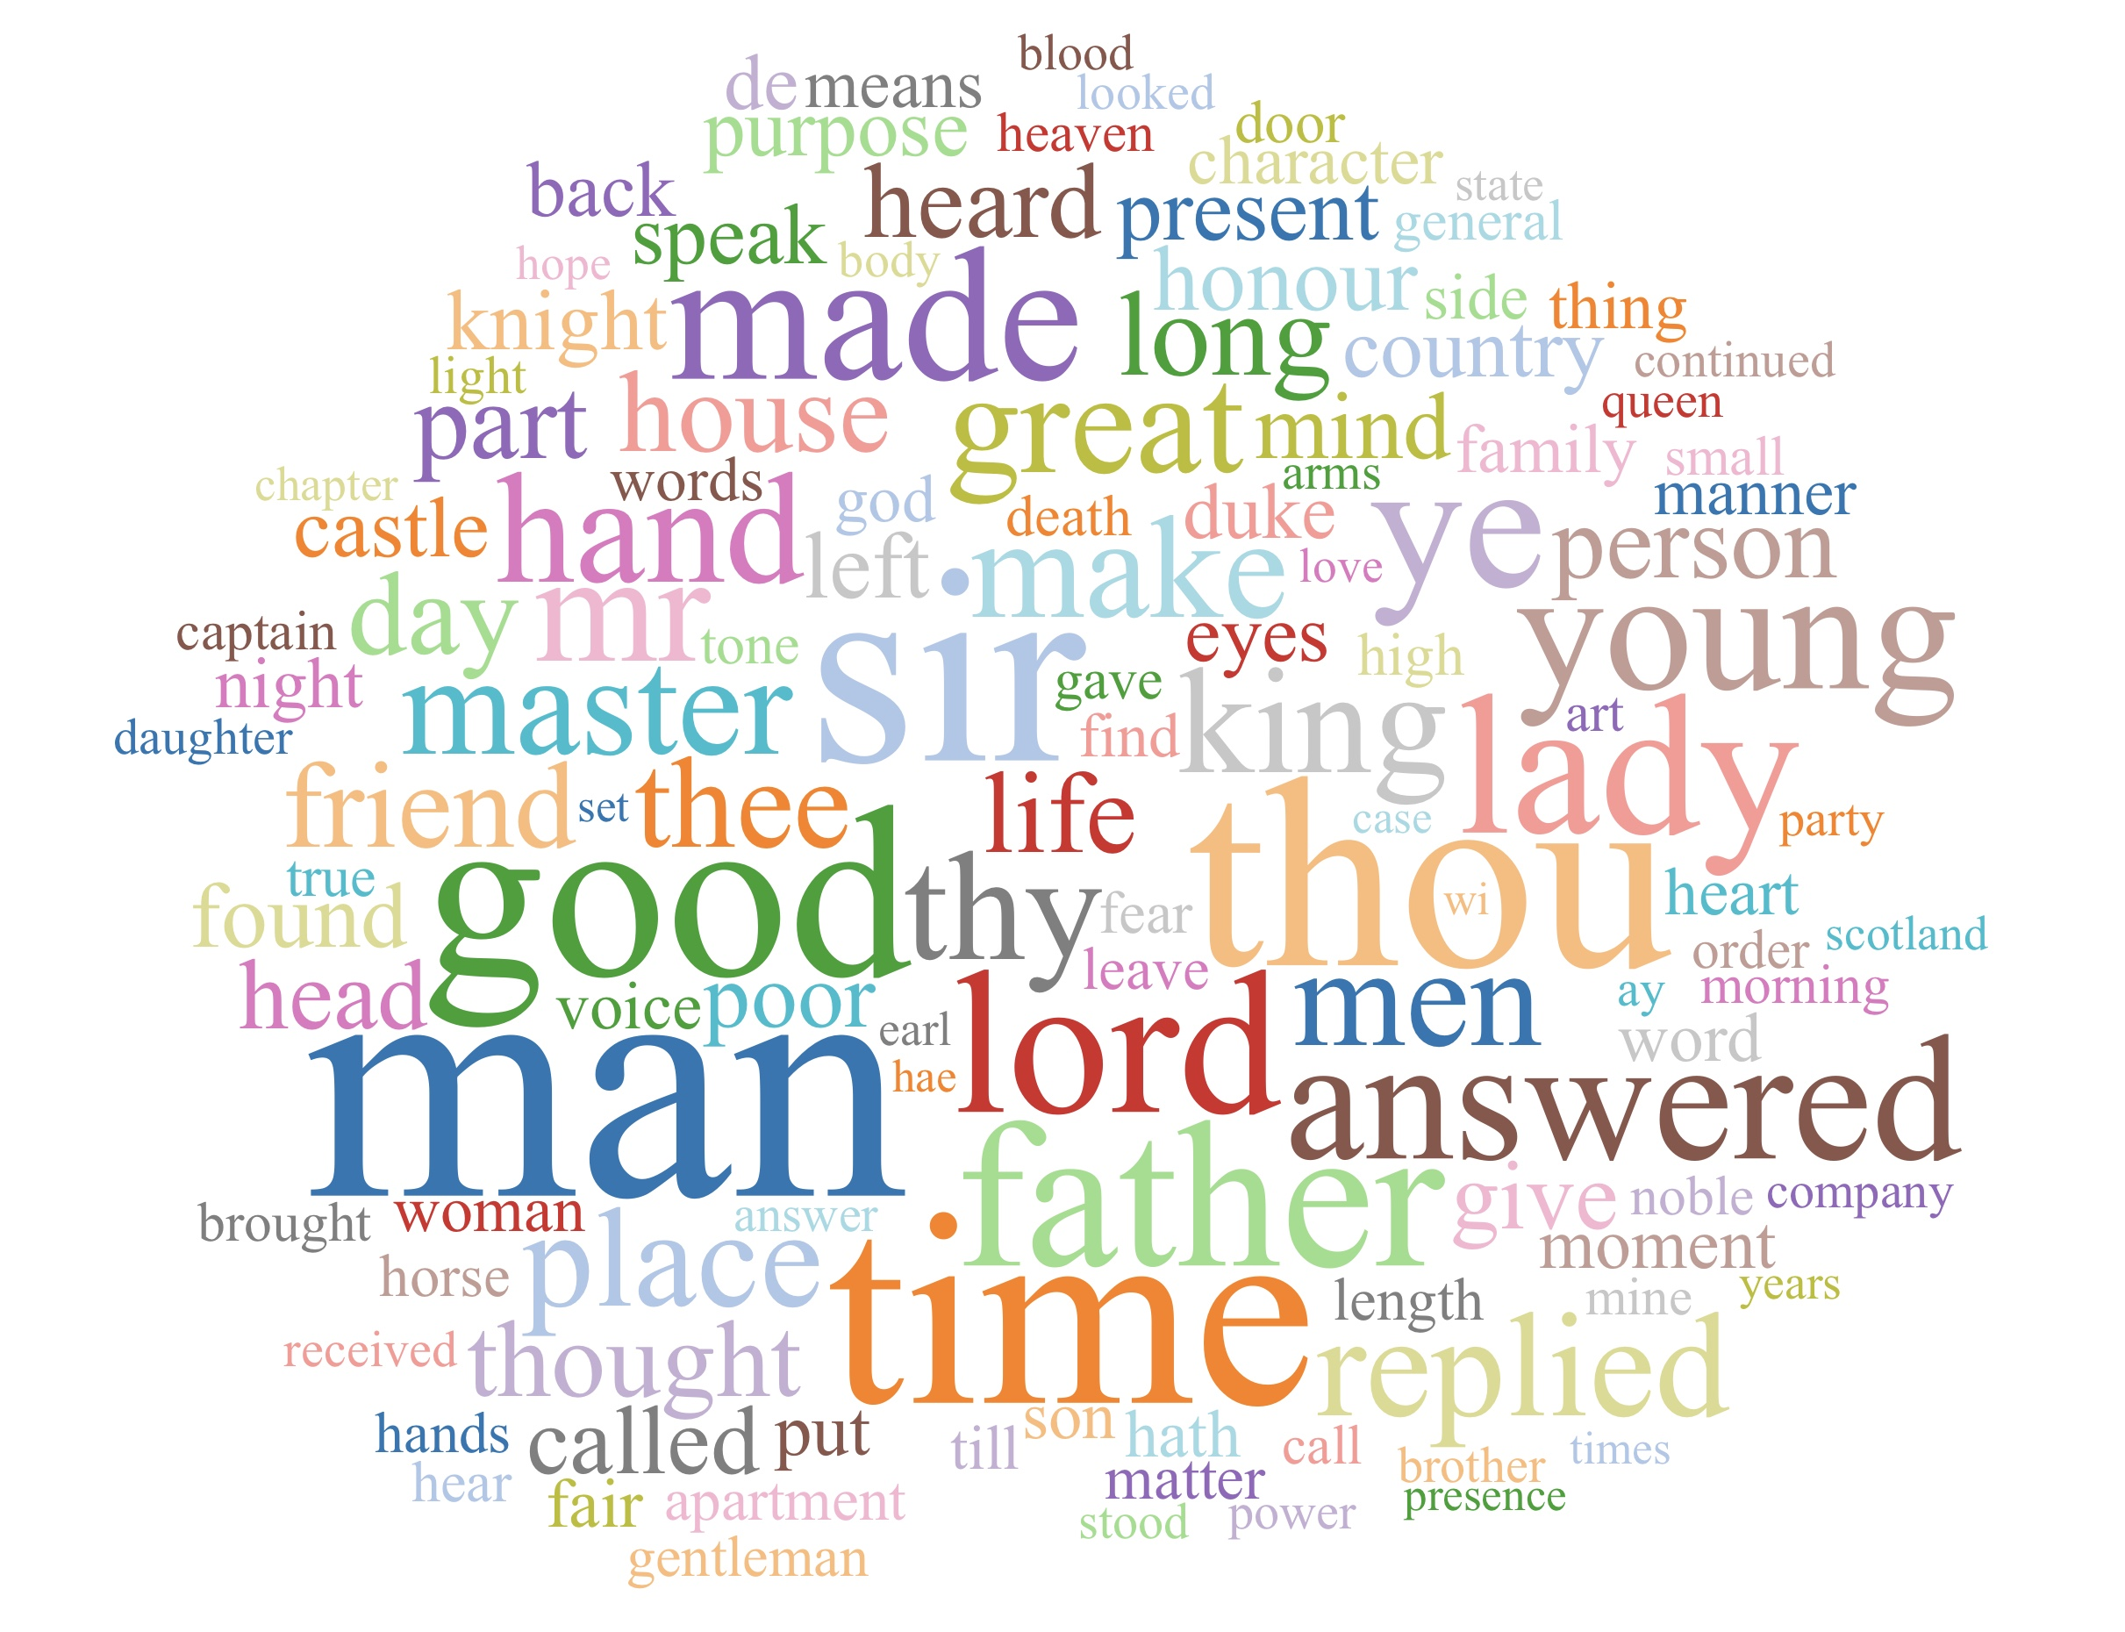
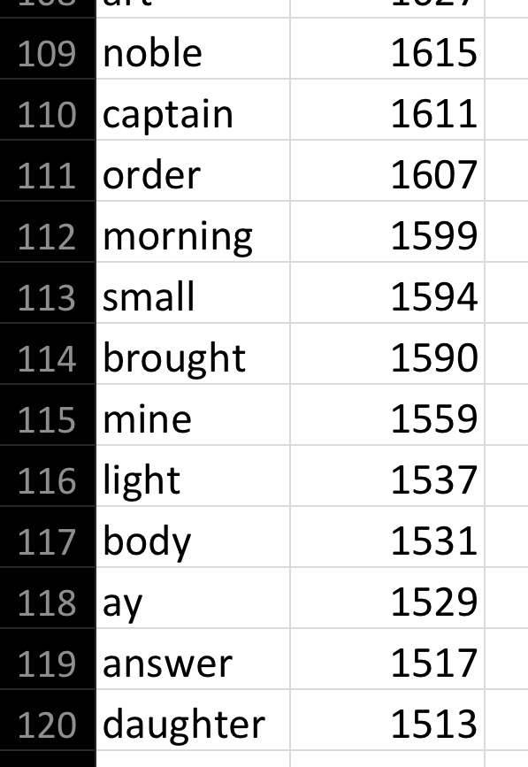
Token Count
and
Tag Cloud Creator
Walter, Scott. Waverly Novels. 48 vols. Edinburgh: R. Cadell, 1829-1833.
Notes:
The Token count and Tag Cloud creator generates a word cloud that illustrates word frequency and also provides a downloadable word-frequency CSV file that can be opened in any standard spreadsheet program, like Microsoft Excel.

Slide 50
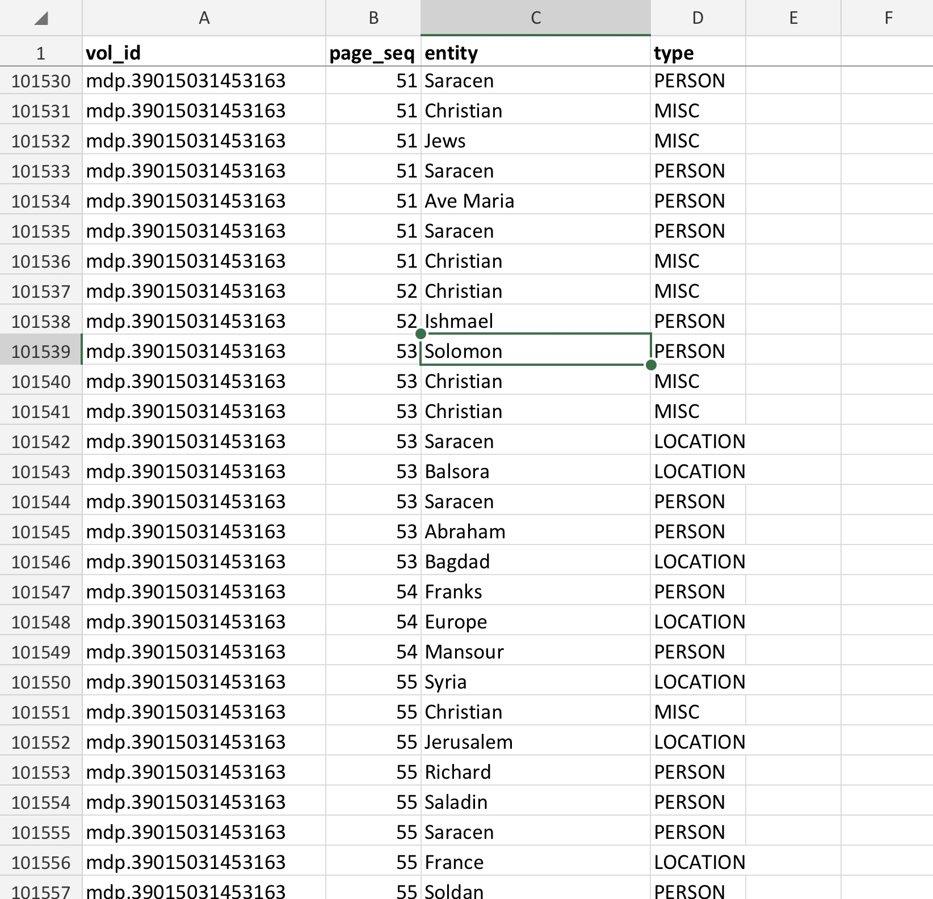
Named
Entity
Recognizer
Walter, Scott. Waverly Novels. 48 vols. Edinburgh: R. Cadell, 1829-1833.
Notes:
The Named Entity Recognizer, based upon Stanford's Named Entity Recognizer implementation, provides a Web interface for generating lists of entities in the user's corpus. Here we see a very small snippet of named entities found in Scott's _Waverly_ novels.

Slide 51
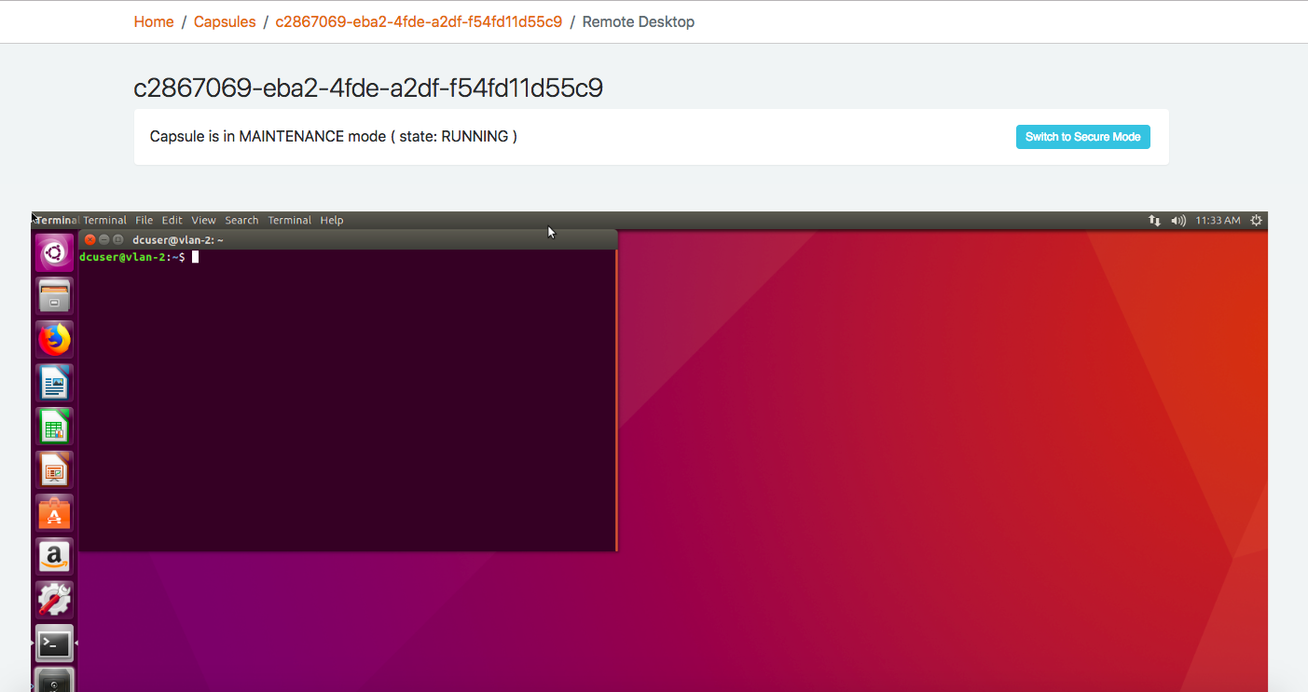
Data
Capsule
Walter, Scott. Waverly Novels. 48 vols. Edinburgh: R. Cadell, 1829-1833.
Notes:
The Data capsules are secure Linux virtual machines, where users can install software and code libraries of their choosing, including software they write themselves. In data capsule users can securely download HT content, and perform custom text analysis in a Linux environment. Data capsules are generally used by more technical users who have some programming skills and are comfortable in a Linux command-line environment.
However, there is also a graphical user interface in the Data Capsule, and we continue to explore ways to make the Data Capsule accessible to less advanced technical users. For instance, we've installed the Voyant suite of web-based text analysis tools inside the data capsule.

Slide 52
HTRC Services: Outreach and Education
Training and workshops
Online documentation
Virtual help: online office hours
Advanced Collaborative Support (ACS) program
Notes:
So far I've focused on the various Text and Data Mining datasets and tools that we offer. Just as important as these datasets and tools are the many outreach and education services we provide to the HathiTrust community and our users.These services include:
Training and workshops for librarians and researchers;
Online help and documentation and virtual office hours;
And our Advanced Collaborative Support program.

Slide 53
Advanced Collaborative Support program
Examples:
Building large-scale collections of genre fiction; Laure Thompson and David Mimno (Cornell)
Mapping scientific names to the HathiTrust Digital Library; Matthew J. Yoder and Dmitry Mozzherin (University of Illinois)
Deriving Basic Illustration Metadata; Stephen Krewson (Yale)
Modeling the History of Book Design; David Bamman and Bjorn Hartmann, University of California, Berkeley
A Computational History of the U.S. Novel, 1950-2000; Richard Jean So, McGill University
The Chicago School: Wikification as the First Step in Text Mining in Architectural History; Dan Baciu, Illinois Institute of Technology
Notes:
Since 2015, we've conducted four rounds of the ACS program. We issue a call for proposals, which then go through a review process. Selected projects receive advanced or intensive support from HTRC staff in developing their project. They may receive assistance with tasks such as collection-building, data clean-up, and coding/algorithm support.
Here we list a few of the projects we have supported through the ACS program. These illustrate the exciting diversity of interests and topics that are being explored using HTRC tools and the HT digital library.

Slide 54
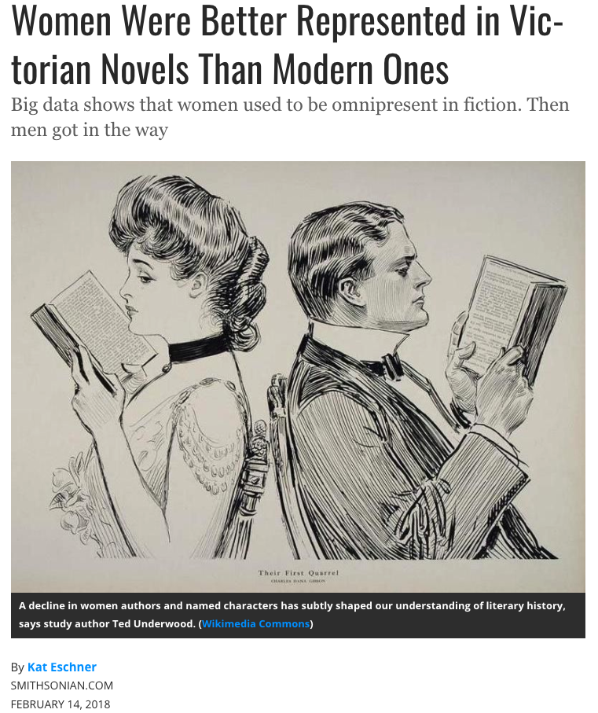
HTRC-Enabled Research: Example
U of Illinois English Prof. Ted Underwood ,U of Cal-Berkeley Info Science Prof. David Bamman, and Sabrina Lee, U of Illinois
Algorithm analyzed the characters and authors of 104,000 novels (1703 to 2009) in HathiTrust.
Findings: a paradox. As rigid gender roles seemed to dissipate moving into the 20th C. , indicating more equality between the sexes, the number of women characters— and proportion of women authors—decreased.
Published in the journal Cultural Analytics
Source: https://www.smithsonianmag.com/arts-culture/what-big-data-can-tell-us-about-women-and-novels-180968153/
Notes:
I close with a slide highlighting some research by Ted Underwood and David Bamman, two heavy users of our services. In analyzing 104,000 novels published from 1703 to 2009, they found that as rigid gender roles seemed to dissipate moving into the 20th century, indicating more equality between the sexes, the number of female characters and the proportion of female authors _decreased_. Their work is another example of the important things we can learn from text data mining methods applied to a large collections like the HathiTrust Digital Library.

Slide 55
The following slides were left out of my original presentation and serve either to illustrate or amplify some of the points I was making in the talk. They are included here for references.

Slide 56
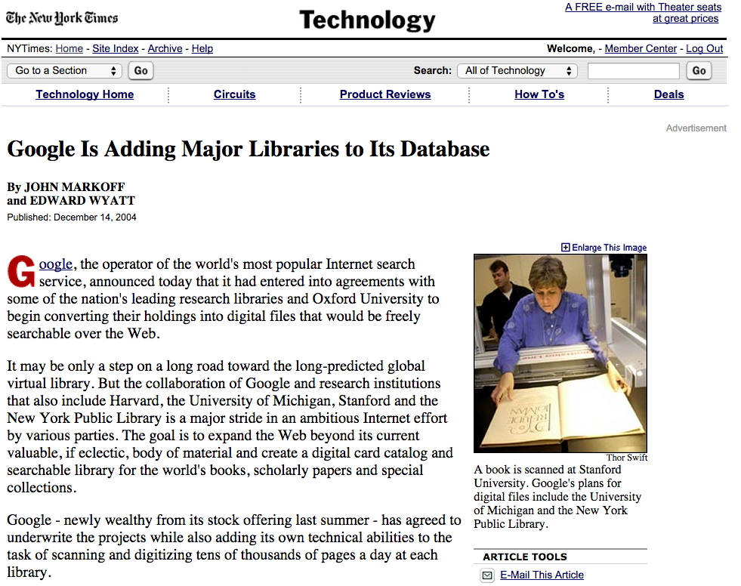

Slide 57
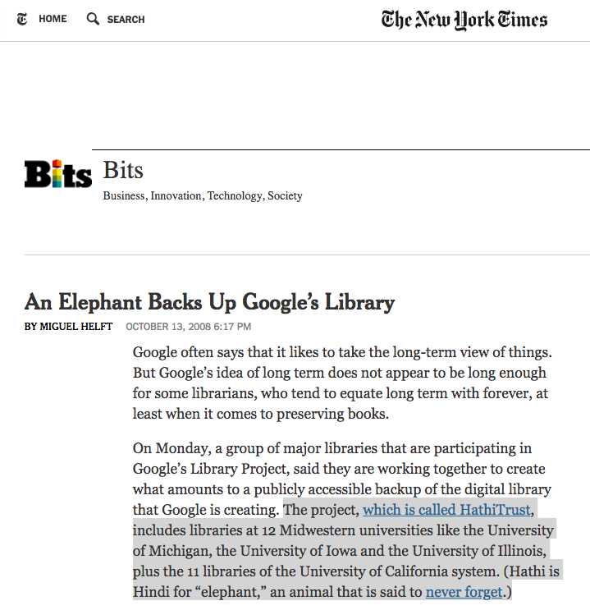
October 13, 2008
HathitTrust launches
with 12 founding members from the Committee on Institutional Cooperation and the 11 libraries of the University of California.
?
Notes:
These libraries made a commitment to a long-term COLLECTIVE INVESTMENT in infrastructure, but also in future stewardship, future access….future users
New York Times saw fit to cover this, though they portrayed this as a “backup” for Google…. WHOSE LIBRARY, EXACTLY?
ADDS SCALE NO MATTER YOUR SIZE
IMAGE CREDIT: New York Times Website, Accessed October 25, 2018

Slide 58
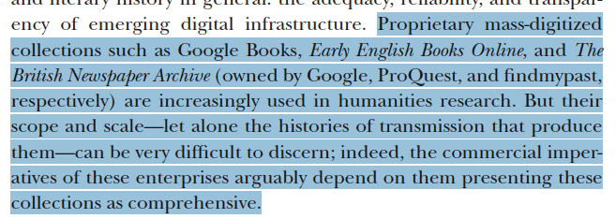
From Karen Bode, A World of Fiction: Digital Collections and the Future of Literary History, Univ of Michigan Press; pp 44, 47

Slide 59
Notes:
Updated to December 31, 2018
Google: 94.82%
Internet Archive: 3.53%
Member digitized: 1.66%

Slide 60
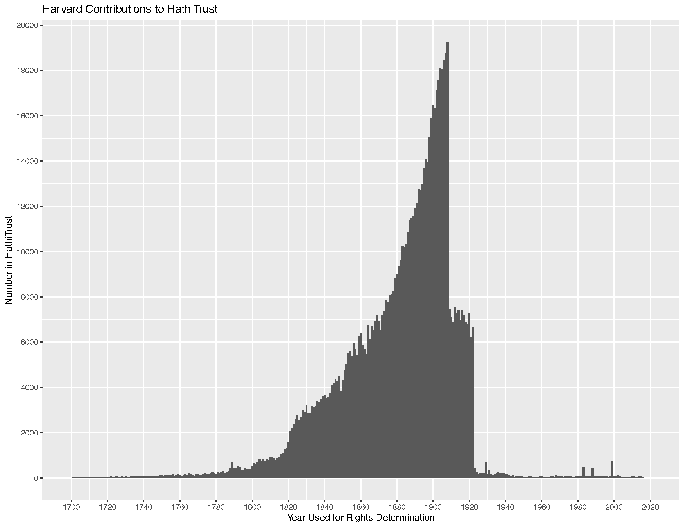

Slide 61
2019:
Welcomed four new staff who add much needed strength in collection management, researcher support and training, enterprise architectures, and metadata quality.
Approved formal Membership Criteria, Fee Model changes, and Bylaws regarding Board of Governors leadership.
In 2020
Focus on infrastructure and analytics
Improve member engagement support
Launch new strategically aligned governance groups
HathiTrust empowers its member libraries and their patrons through a durable, sustainable, and transparent organization and open infrastructure.
Notes:
Develop new analytic capacities to support service improvements, collection development, and member engagement.
Engineer the HathiTrust infrastructure as a more open platform for distributed activities and services.
In 2020 we set up the work for the remainder of our planning cycle.
The applications and systems that support the digital library, administration, and programs of HathiTrust serve us well, but are due for a re-assessment so that the infrastructure can continue to support our evolving needs.
As we begin that work, we will new attention to developing our ability to make use of the significant amounts of data available about the collection, how it is used, and how it relates to the collections of our members and non-members.
Careful uses of business data will supplement our understanding, decision-making, and planning.
Our members will use HathiTrust data to support their own local collection management decisions.
Our frontend and backend systems will support our evolving strategies.
Members need clear and straightforward information about HathiTrust to make the most of HathiTrust membership and to take an active role in governance.
Now that we have formally delineated our membership criteria and adopted modifications to our cost-sharing models, we can begin more thoughtful and targeted recruitment of new members to strengthen HathiTrust and our activities.

Slide 62
In 2019:
Improved digital library accessibility for those with print disabilities
Re-opening of public domain
Launched a new workshop series for HTRC
In 2020:
Focus on discovery and delivery
Begin implementation of Metadata Sharing Policy
HathiTrust bolsters content discovery and diversifies uses of the scholarly record through services that improve the quality of the collection and the user experience.
Notes:
BACK TO 2019 HIGHLIGHTS
I won’t say much here – you’ll hear more about these in the next couple of hours.
I promised Angelina, Kristina, Jessica, and Eleanor that I would not step on their talks.
When they are speaking, you just think “…..so much enhancement! Beautiful enhancement.”
Redefine our discovery and access approaches to support
greater interoperability and frictionless use of our collection.
Enable robust transformative uses of the corpus, and open for reading
more of the collection wherever lawfully possible.
We will understand how users find us now and how libraries direct their users to us.
Users will discover HathiTrust through our collection, not our collection through HathiTrust.
Our discovery strategies will change as discovery methods evolve.
Our data mining expertise will help us expand our notions of discovery and access.

Slide 63
In 2019:
Completed Phase 2 of the Shared Print Program
Partnered with three major UK libraries to explore how to better document and identify mass digitized materials
In 2020:
Focus on strategies for growth and leverage
Articulate collection strategy
Plan/workshop next level services from Shared Print Program.
Improving discovery for accessible learning materials
HathiTrust addresses significant challenges libraries cannot independently confront to advance innovative forms of research, pedagogy, and public engagement.
Notes:
TRANSFORM
Work we group around the “Transform” theme is intended to be that work that addresses significant challenges libraries cannot independently confront to advance innovative forms of research, pedagogy, and public engagement.”
This is about the cumulative effect of the rest of our work — about how we can make bigger waves in the pond.
In 2019 some of the most notable work here was the continuation of our Shared Print Program
Phase 2 for shared print leaves us with 18 million commitments for about 5 million monograph titles (about 76% of HTs collection) at 79 different HT member campuses.
Marks a turning point — we planned and made an initial push when launched — get to scale with commitments, build the network, get data, begin to understand the landscape of commitments better. Tremendous thanks and accomplishment. Heather Weltin
Going ahead
Let’s stay with these theme of the collection and related programs.
Deepen and add breadth to the HathiTrust collections, guided by a targeted, intentional strategy for new and retrospective publications.
Develop robust frameworks for large-scale collection management, access, and preservation
The question we’ll be asking here is:
How?
What next?
So what?
Focus on strategies for growth and leverage
Articulate intentional, not just reactive collection strategy
Plan/workshop next level services from Shared Print Program.
Improving discovery for accessible learning materials
Why So What?
Argue again that our ability to collectively aggregate 17 million volumes is an opportunity to do more to transform collection access and management

Slide 64
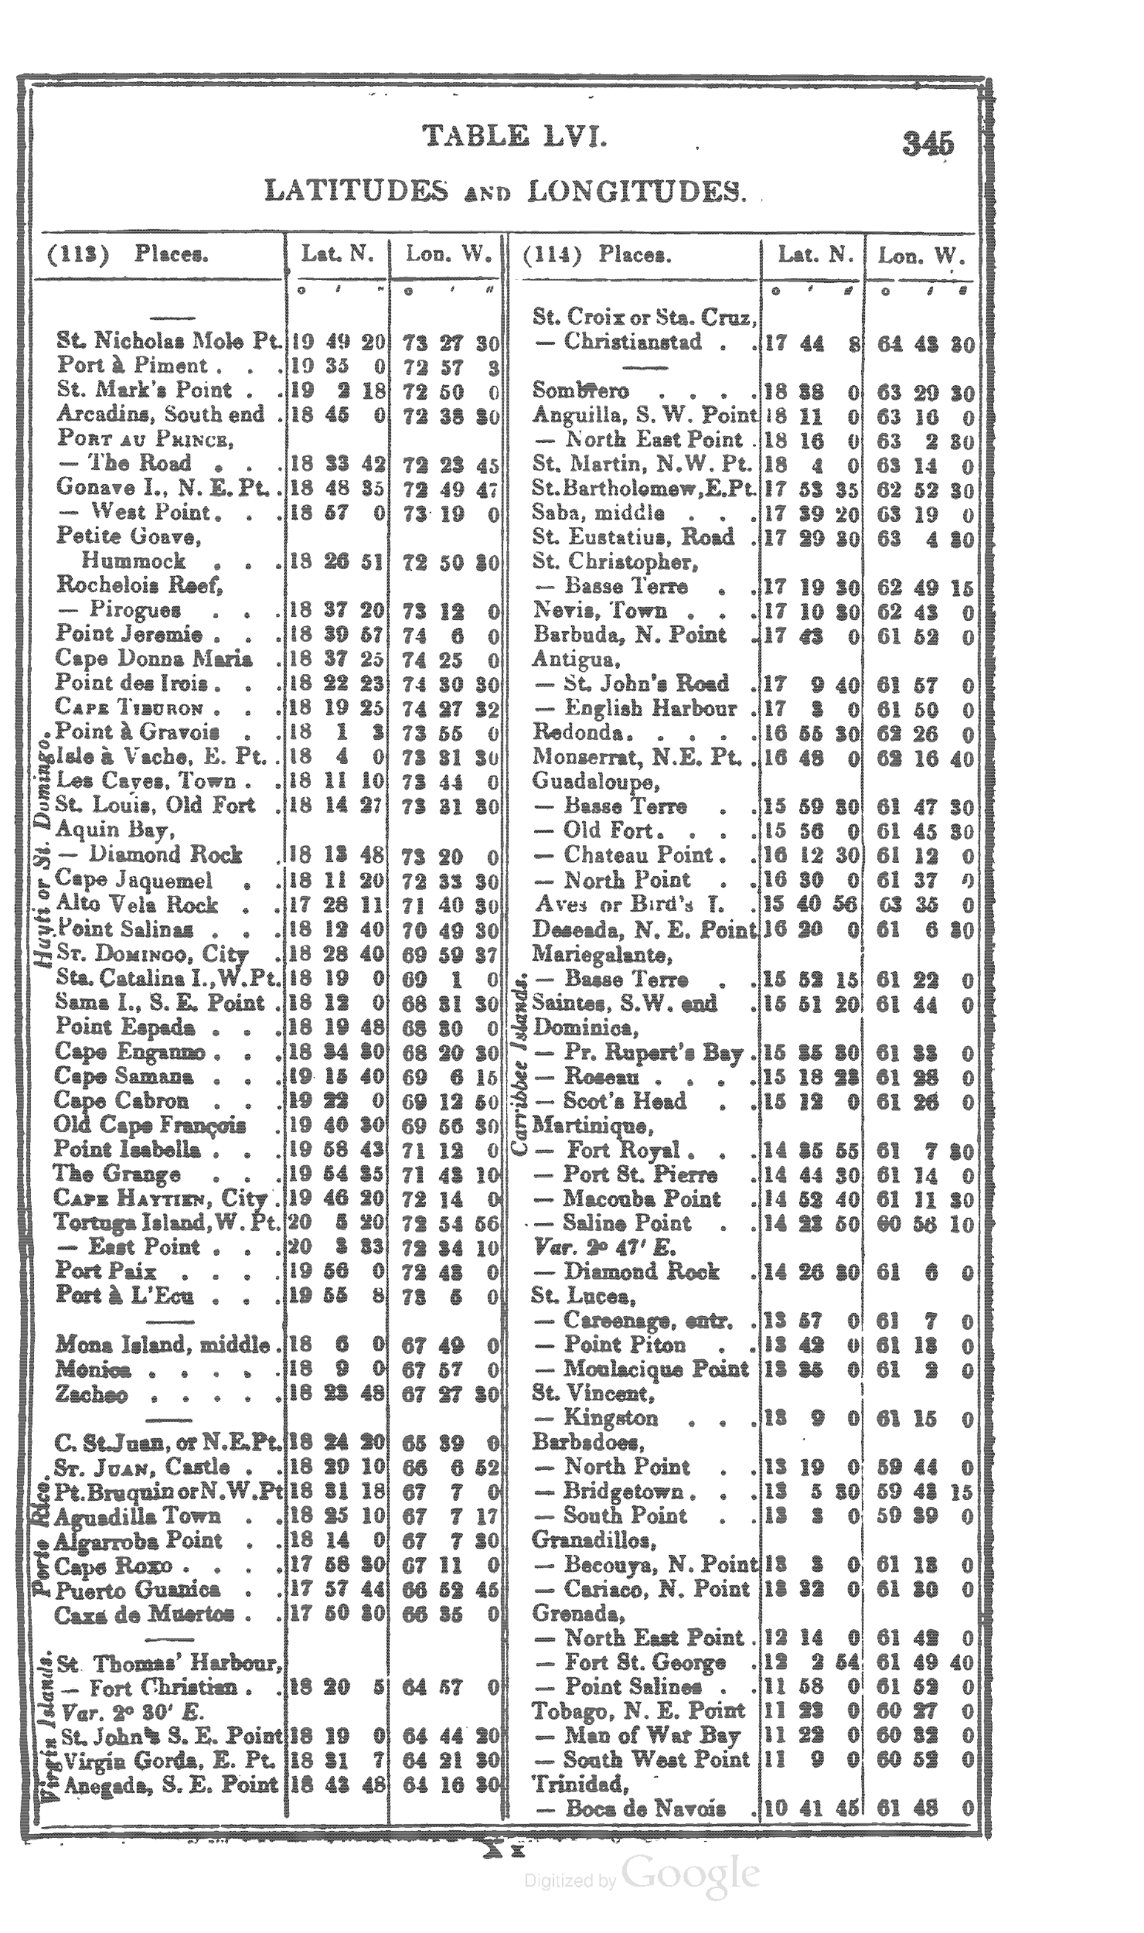
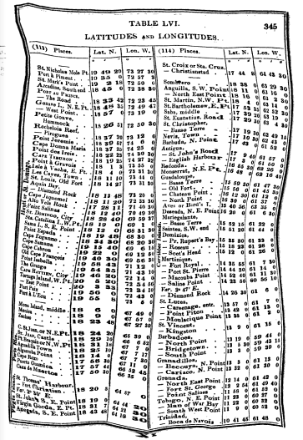
HathiTrust handles several hundred quality reports per year.
We work with depositing members or the digitization source to resolve these.
Notes:
And at first, a lot of things weren’t good enough. Quality of image scans and metadata were visible problems that critics could use to pummel the partnerships.
There were gleeful presentations and articles that would trot out bad scan after bad scan.
But what many did not know was that the Libraries themselves had been pushing Google on quality from the very start--even before it became public. They pushed Google very hard to improve image quality, OCR quality, and metadata.
And over time, things did improve. Google’s mechanics, processing, and workflows improved and made a difference.
The Libraries pushed to be able to fix volumes after the fact. HathiTrust still fields hundreds of requests per year to fix bad scans, and we work with the depositing member libraries to re-scan and insert pages where needed.
Left image via Art of Google Books: cited as From p. 345 of A New and Complete Epitome of Practical Navigation by John William Norie (1839). Original from Oxford University. Digitized October 24, 2006.” Accessed October 24, 2018.
Right image via Google Books: https://books.google.com/books?id=nocEAAAAQAAJ&dq=practical&pg=PA345#v=onepage&q&f=false Same volume, image apparently reprocessed to correct warp. Accessed October 24, 2018

